Slide 1

Fundamentals of Data Structures
S. Y. B. Tech CSE
Semester – III
SCHOOL OF COMPUTER ENGINEERING AND TECHNOLOGY

Slide 2

Linear Data Structures
Linear Data Structures: Array as an Abstract Data Type, Sequential Organization, Storage Representation and their Address Calculation: Row major and Column Major, Multidimensional Arrays: Concept of Ordered List, Single Variable Polynomial: Representation using arrays, Polynomial as array of structure, Polynomial addition, Polynomial evaluation and Polynomial multiplication. Sparse Matrix: Sparse matrix representation using array, Sparse matrix addition, Transpose of sparse matrix- Simple and Fast Transpose, Time and Space tradeoff.
11/27/2018
2
Notes:
2
MIT-WPU

Slide 3
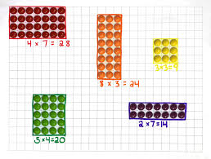
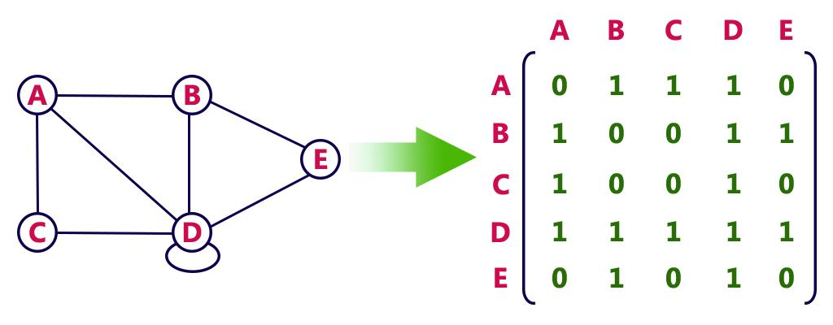
Applications of an Array
11/27/2018
3

Slide 4
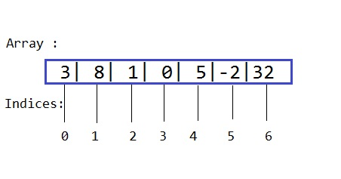
Array as an Abstract Data Type
Array is set of pairs – index and value.
For each index, there is a value associated with it.
Arrays are often stored in consecutive set of memory locations.
Mainly two operations perform on array are retrieve and store values.
11/27/2018
4
Notes:
4
MIT-WPU

Slide 5
Array as an Abstract Data Type
structure ARRAY (value, index)
Declare CREATE() -> array
RETRIEVE(array, index) -> value
STORE(array, index, value) -> array;
for all A ∈ array, i, j ∈ index, x ∈ value let
RETRIEVE(CREATE() , i) ::= error
RETRIEVE(STORE(A, i, x) , j) ::= val
end
end ARRAY
The function CREATE produce a new empty array.
RETRIEVE takes as input an array and an index and either returns the appropriate values or an error.
STORE is used to enter new index-value pairs
11/27/2018
LINEAR DATA STRUCTURE (DS-I)
5
Notes:
5
MIT-WPU

Slide 6
Sequential Organization
In sequential organization, elements are stored in consecutive memory locations. Ex- array
Properties of sequential data structure are:
Simple to use
Simple to define
Constant access time
Mapping by compiler
An array element can be accessed by a[i] where a is the name of the array and i is the index.
11/27/2018
6
Notes:
6
MIT-WPU

Slide 7
Sequential Organization
Compiler maps a[i] to its physical location in memory.
Address of a[i] is given by
starting address of a + i * size of array elements in bytes
This mapping is carried out in constant time, irrespective of which element is being accessed.
Limitations:
Size of an array is defined at the time of programming
Insertion and deletion is time consuming
Requires contiguous memory
11/27/2018
7
Notes:
7
MIT-WPU

Slide 8

Memory Representation and Address Calculation
1-D Array
1-D array is a list of elements or simply a row of elements.
In mathematic, we often deal with variable that are simple scripted –
Where x_{i} refers to the i^{th} element of x variables can be expressed as – x[0], x[1], …. X[4]
11/27/2018
8

Slide 9
Memory Representation and Address Calculation
Example: 1-D array A[7] where A is array name and 7 is size.
Syntax: int A[7];
index | value | Memory address
[0] | 10 | 1024
[1] | 20 | 1028
[2] | 30 | 1032
[3] | 40 | 1036
[4] | 50 | 1040
[5] | 60 | 1044
[6] | 70 | 1048
11/27/2018
9

Slide 10
Memory Representation and Address Calculation
Address of 1st element of an array is called Base Address (BA).
Address of i^{th} element = BA+ offset of the i^{th} element from BA
Where offset =( number of element before i^{th} element)* size of each element
Ex: consider an array : int a[10]; and BA = 403, size of element = 4 bytes. Calculate address of a[3]?
a[3] = 403 + (3*4) = 403 + 12 = 415
11/27/2018
10
Notes:
10
MIT-WPU

Slide 11
Memory Representation and Address Calculation
2-D Array
2-D arrays can be thought of as a table consisting of rows and columns.
It is also called as matrix.
1st dimension is referred as row and 2nd dimension is referred as column.
The elements of 2D array may be arranged either row wise or column wise.
11/27/2018
11
Notes:
11
MIT-WPU

Slide 12
Memory Representation and Address Calculation
Ex: int a[3][4]; //declares an integer array of 3 rows and 4 columns
In memory, all elements are stored linearly using contiguous addresses.
int a[3][4]; | Col 0 | Col 1 | Col 2 | Col 3
Row 0 | a[0][0] | a[0][1] | a[0][2] | a[0][3]
Row 1 | a[1][0] | a[1][1] | a[1][2] | a[1][3]
Row 2 | a[2][0] | a[2][1] | a[2][2] | a[2][3]
11/27/2018
12
Notes:
12
MIT-WPU

Slide 13
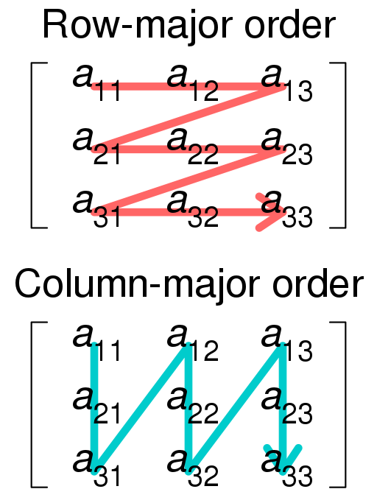
Memory Representation and Address Calculation
In order to store 2D matrix, a 2D address space must be mapped to 1D address space.
In computer memory, matrices are stored in either row-major form or column-major form.
11/27/2018
13
Notes:
13
MIT-WPU

Slide 14
Memory Representation and Address Calculation
Column-major representation:
if the elements are stored column-wise manner then it is called column major representation.
int A[3][4]; Column-major:
A= A =
1 | 2 | 3 | 4
5 | 6 | 7 | 8
9 | 10 | 11 | 12
1 | 4 | 7 | 10
2 | 5 | 8 | 11
3 | 6 | 9 | 12
11/27/2018
14
Notes:
14
MIT-WPU

Slide 15
Memory Representation and Address Calculation
Address of an element a_{ij} (row-major) =BA+(row_index*total_no_of_col+col_index)*S; or
B + (i – L1) * (U2 – L2 + 1) * S + ( j – L2) * S
Where B = base address
L1 & U1 are lower and upper bound values for rows
L2 & U2 are lower and upper bound values for columns
S is Number of bytes taken to store element
Ex: int a[3][4]; BA = 100; S=4 bytes; Find location of a[2][1] row-wise?
A[2][1] = 100 + (2-0) * (4 – 0 + 1) * 4 + (1 – 0 ) * 4 100+(2*4+1)*4
= 100 + 2 * 5 * 4 + 4 100+44
= 100 + 40 + 4 144
= 144
11/27/2018
15
Notes:
15
MIT-WPU

Slide 16
Memory Representation and Address Calculation
Address of an element a_{ij} (column-major) =
BA+(col_index*total_no_of_row+row_index)*S; or
B + (j – L2) * (U1 – L1 + 1) * S + ( i – L1) * S
Where B = base address
L1 & U1 are lower and upper bound values for rows
L2 & U2 are lower and upper bound values for columns
S is Number of bytes taken to store element
Ex: int a[3][4]; BA = 100; S=4 bytes; find location of a[2][1] col-wise?
A[2][1] = 100 + (1-0) * (3 – 0 + 1) * 4 + (2 – 0 ) * 4 100+(1*3+2)*4
= 100 + 1 * 4 * 4 + 8 100+24
= 100 + 16 + 8 124
= 124
11/27/2018
16
Notes:
16
MIT-WPU

Slide 17
Row -major and Column -major Address
Example:
int a[3][4],Base address 1050 s=4,find a[2][3] in row major and column major representation
Row-major :
A[2][3]=1050+(2*4+3)*4
= 1050+44
=1094
Column-major:
A[2][3] =1050+(3*3+2)*4
= 1050+44
= 1094
11/27/2018
17

Slide 18
Multidimensional Array
In C/C++, multidimensional arrays can be used as array of arrays.
Data in multidimensional arrays are stored in tabular form (in row major order).
Declaration
General form of declaring N-dimensional arrays:
data_type array_name[size1][size2]....[sizeN];
e.g. int a[5][10][20];
Size of multidimensional arrays
Total number of elements that can be stored in a multidimensional array can be calculated by multiplying the size of all the dimensions.
int a[5][10][20];
1000 elements in an array ‘a’.
11/27/2018
18

Slide 19
Memory Representation and Address Calculation (row-major)
a[S₁][S₂]…[S_{N}]
Address of an element a_{ij}
Address of a[I₁][I₂]. . . .[l_{N}] = B + W*[((E₁S₂ + E₂ )S₃ +E₃ )S₄ ….. + E_{N-1})S_{N} + E_{N}]
Where B = base address
W represents the size of an element in bytes
E_{i} is given by E_{i} = l_{i} – t_{i}, where l_{i} and t_{i} are the calculated indexes (indices of array element which needs to be determined) and lower bounds respectively.
S₁, S₂, S₃, ………, S_{N} are dimensions
l₁, l₂, l₃, …………..l_{N} are indices of the element whose address needs to be calculated.
11/27/2018
19
Notes:
19
MIT-WPU

Slide 20
Memory Representation and Address Calculation (row-major)
Example
int A[10][20][30][40] with base address 1200
Find the address of element A[1][3][5][6]
B = 1200 and W = 4, S₁ = 10, S₂ = 20, S₃ = 30, S₄ = 40
Lower bounds is zero.
E₁ = 1 – 0 = 1
E₂ = 3 – 0 = 3
E₃ = 5 – 0 = 5
E₄ = 6 – 0 = 6
A[I₁][I₂]. . . .[l_{N}] = B + W*[((E₁S₂ + E₂ )S₃ +E₃ )S₄ ….. + E_{N-1})S_{N} + E_{N}]
A[1][3][5][6] = 1200 + 4(((1 × 20 + 3)30 +5)40 + 6) = 112424
11/27/2018
20
Notes:
20
MIT-WPU

Slide 21
Memory Representation and Address Calculation (column-major)
Address of a[I₁][I₂]. . . .[l_{N}] = B + W*[((…E_{N}S_{N-1}+ E_{N-1} )S_{N-2} +… E₃ )S₂+ E₂ )S₁ +E₁]
Example
int A[10][20][30][40] with base address 1200
Find the address of element A[1][3][5][6]
B = 1200 and W = 4, S₁ = 10, S₂ = 20, S₃ = 30, S₄ = 40
Lower bounds is zero.
E₁ = 1 – 0 = 1
E₂ = 3 – 0 = 3
E₃ = 5 – 0 = 5
E₄ = 6 – 0 = 6
A[I₁][I₂]. . . .[l_{N}] = B + W*[((…E_{N}S_{N-1}+ E_{N-1} )S_{N-2} +… E₃ )S₂+ E₂ )S₁ +E₁]
A[1][3][5][6] = 1200 + 4(((6*30+5)20+3)10+1) = 149324
11/27/2018
21
Notes:
21
MIT-WPU

Slide 22
Concept of Ordered List
One of the simplest and most commonly found data object is the ordered or linear list.
Examples
Days of the week
(MONDAY, TUESDAY, WEDNESDAY, THURSDAY, FRIDAY, SATURDAY, SUNDAY)
The values in a card deck
(2, 3, 4, 5, 6, 7, 8, 9, 10, Jack, Queen, King, Ace)
If we consider an ordered list more abstractly, we say that it is either empty or it can be written as
(a1,a2,a3, ...,an)
where the ai are atoms from some set S.
There are a variety of operations that are performed on these lists.
find the length of the list, n;
read the list from left-to-right (or right-to-left);
retrieve the i-th element, ;
store a new value into the i-th position, ;
insert a new element at position causing elements numbered i, i + 1, ...,n to become numbered i + 1, i + 2, ...,n + 1;
delete the element at position causing elements numbered i + 1, ...,n to become numbered i, i + 1, ..., n - 1.
11/27/2018
22

Slide 23
Representation of Ordered List using an Array
Associate the list element a_{i} with the array index i.
This we will refer to as a sequential mapping
Using the conventional array representation we are storing a_{i} and a_{i + 1} into consecutive locations i and i + 1 of the array.
Retrieve or modify the values of random elements in the list is done in a constant amount of time.
11/27/2018
23

Slide 24
Representation of Polynomials using arrays
Polynomial is one of the classic example of an Ordered List.
An ordered list is set of elements where set may be empty or it can be written as a collection of elements such as (a₁, a₂, a₃,…..,a_{n}), where a_{i} are atoms from some set S.
A polynomial is the sum of terms where each term consists of variable, coefficient and exponent.
Ex: A(x) = 3x² + 2x + 4 and B(x) = x⁴ + 10x³ + 3x² + 1
11/27/2018
24
Notes:
24
MIT-WPU

Slide 25
Representation of Polynomials of Degree n in an array
We have a Polynomial-
C_{m-1} X^{m-1} + C_{m-2} X^{m-2}+ …….+ C₀X⁰
Polynomial with n terms can be represented by the ordered list of length 2n+1
(n, (power, coeff), (power, coeff), ……..)
Ex: x³ + 5x² + 9 can be represented as –
(3, (3,1), (2,5), (0,9)) or
x⁴+59x+10
(3, (4, 1), (1, 59), (0, 10)) or
3 | 3 | 1 | 2 | 5 | 0 | 9
3 | 4 | 1 | 1 | 59 | 0 | 10
11/27/2018
25
Notes:
25
MIT-WPU

Slide 26
Representation of Polynomials A (x, y)
If the polynomial has m non-zero terms then the polynomial can be represented as an ordered list of 3m + 1 terms.
m, power of x, power of y, coeff, power of x, power of y, coeff, …
1st term 2nd term
1st entry is the number of non-zero terms. For each term, there are 3 entries- an exponent of x, y and coefficient triple.
11/27/2018
26
Notes:
26
MIT-WPU

Slide 27
Representation of Polynomials A(x, y)
3x³y² + 10xy -1
(3, (3, 2, 3), (1, 1, 10), (0, 0 , -1))
OR
X²+5xy+y²-y-x
(5, (2,0,1), (1,1,5), (0,2,1), (0,1,-1), (1,0,-1))
OR
3 | 3 | 2 | 3 | 1 | 1 | 10 | 0 | 0 | -1
5 | 2 | 0 | 1 | 1 | 1 | 5 | 0 | 2 | 1 | 0 | 1 | -1 | 0 | 0 | -1
11/27/2018
27
Notes:
27
MIT-WPU

Slide 28
Representation of Polynomials A (x, y, z)
If the polynomial has m non-zero terms then the polynomial can be represented as an ordered list of 4m + 1 terms.
m, power of x, power of y, power of z, coeff, power of x, power of y, power of z coeff, …
1st term 2nd term
1st entry is the number of non-zero terms. For each term, there are 4 entries- an exponent of x, y, z and coefficient.
11/27/2018
28
Notes:
28
MIT-WPU

Slide 29
Representation of Polynomials A (x, y)
5x³y²z + 3x²y³z² + 6xyz³ + 10
(4, (3, 2, 1, 5), (2, 3, 2, 3), (1, 1, 3, 6), (0, 0, 0, 10))
OR
-8x³y³z³ + 10x³y²z + 5xyz² + 10
(4, (3,3,3, -8), (3,2,1, 10), (1,1,2,5), (0,0,0,10))
OR
4 | 3 | 2 | 1 | 5 | 2 | 3 | 2 | 3 | 1 | 1 | 3 | 6 | 0 | 0 | 0 | 10
4 | 3 | 3 | 3 | -8 | 3 | 2 | 1 | 10 | 1 | 1 | 2 | 5 | 0 | 0 | 0 | 10
11/27/2018
29
Notes:
29
MIT-WPU

Slide 30
Addition and Evaluation of Polynomials
Add A(x) = 3x² + 2x + 4 and B(x) = x⁴ + 10x³ + 3x² + 1
Result C(x) = x⁴ + 10x³ + 5x² + 2x + 5
While storing the polynomials in the arrays, we have to store them in the descending order of the exponents.
11/27/2018
30
Notes:
30
MIT-WPU

Slide 31
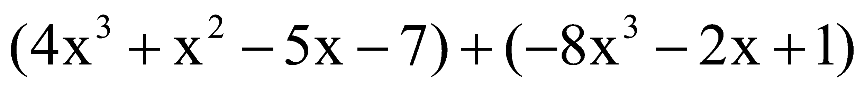
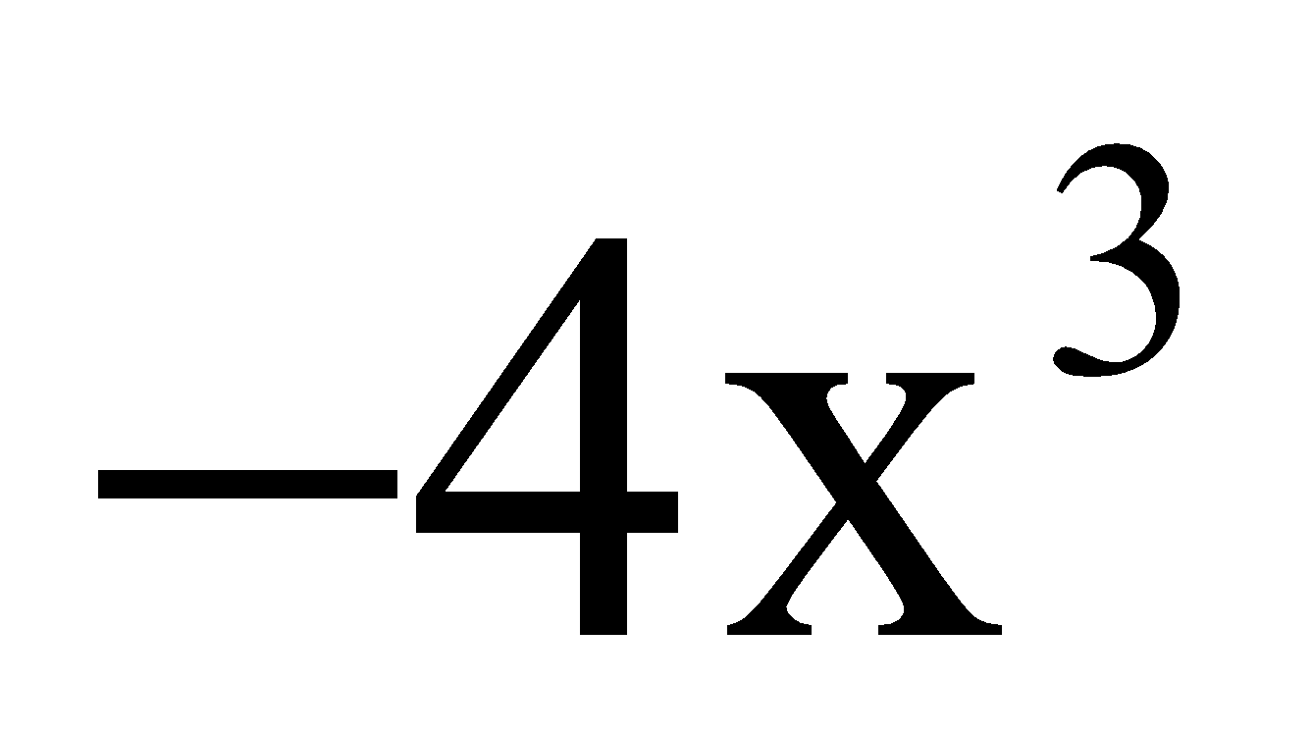
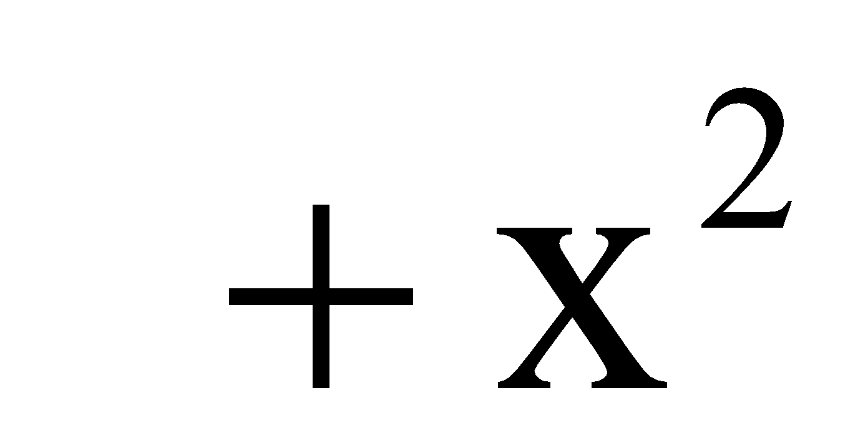
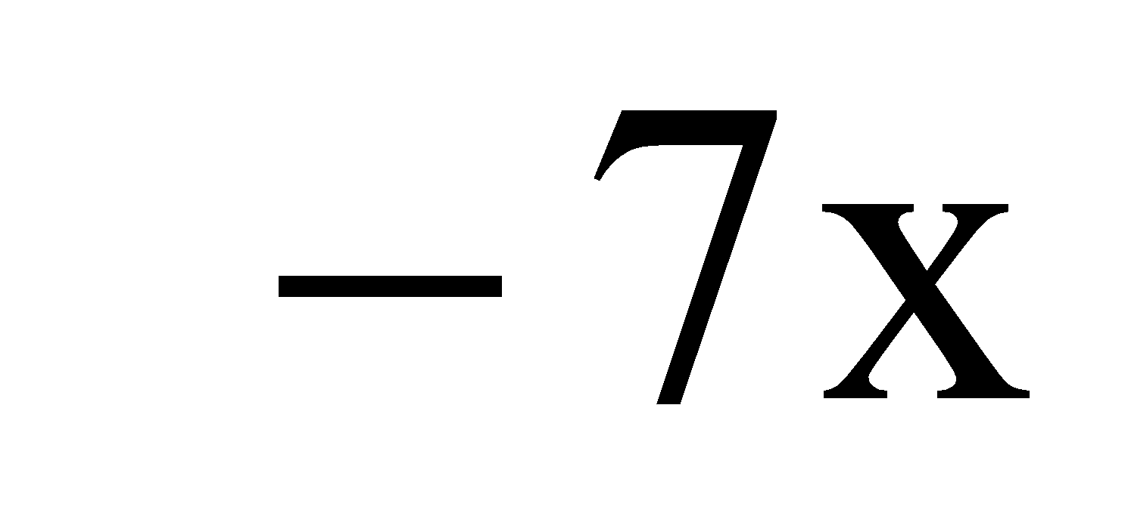
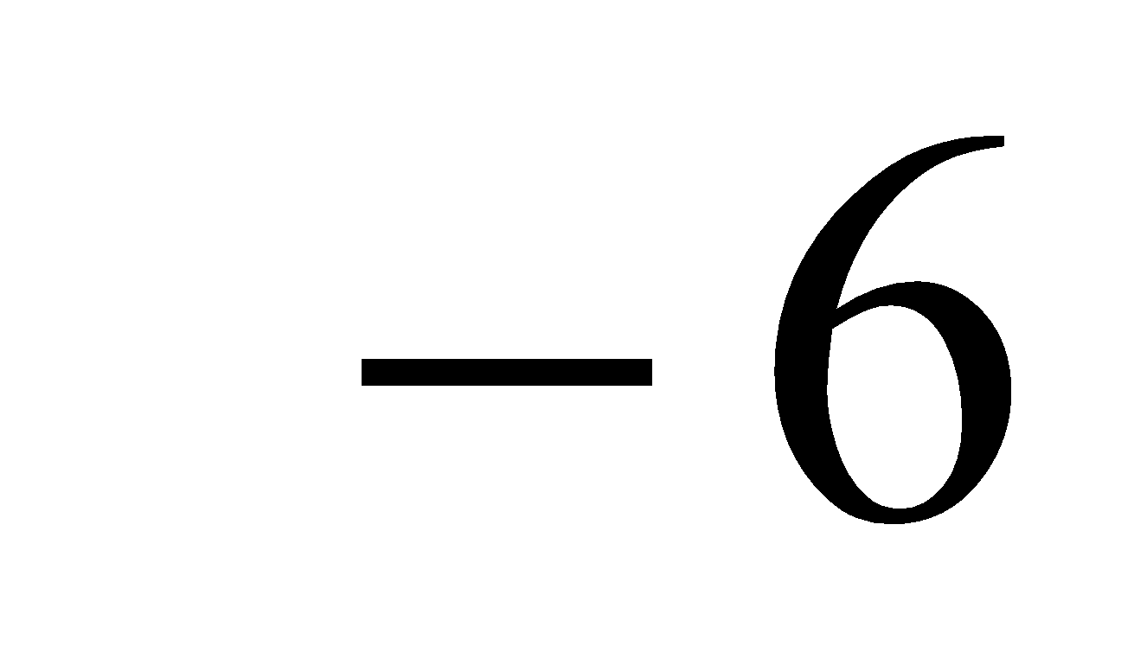
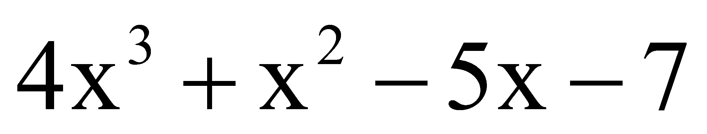
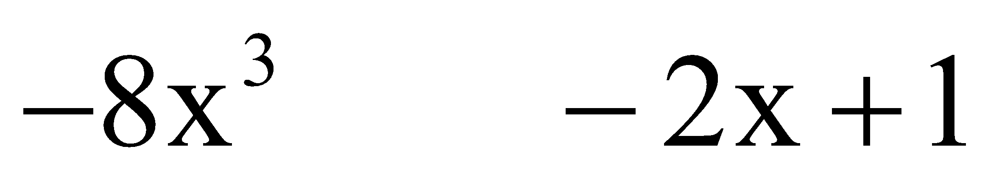
Adding Polynomials
Horizontal Method
Vertical Method
11/27/2018
31
Notes:
31

Slide 32
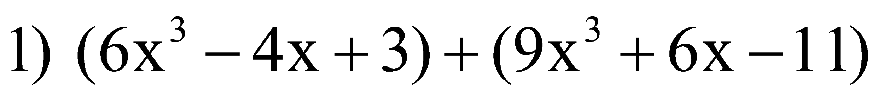
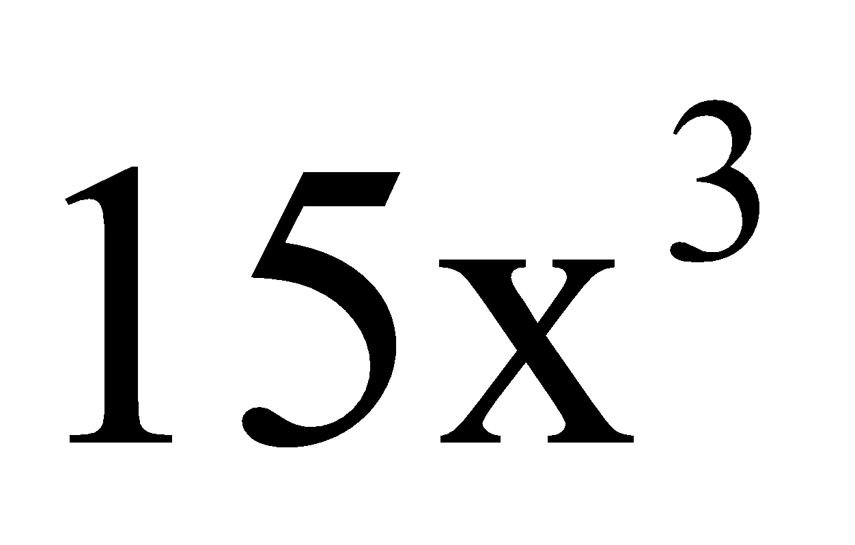
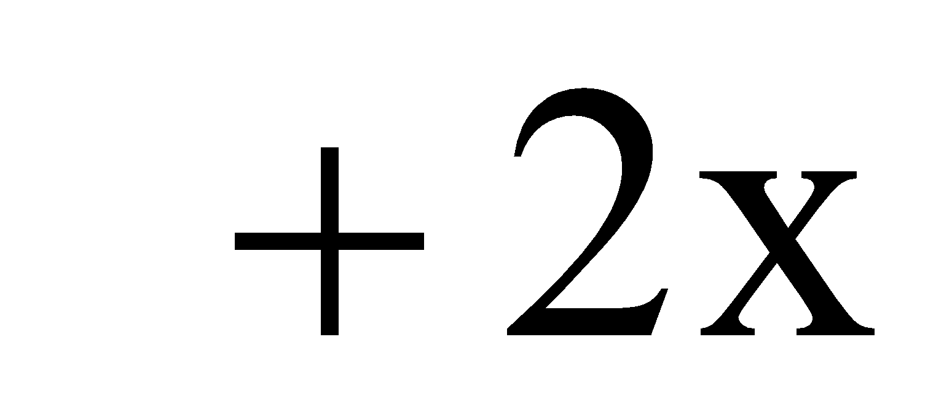
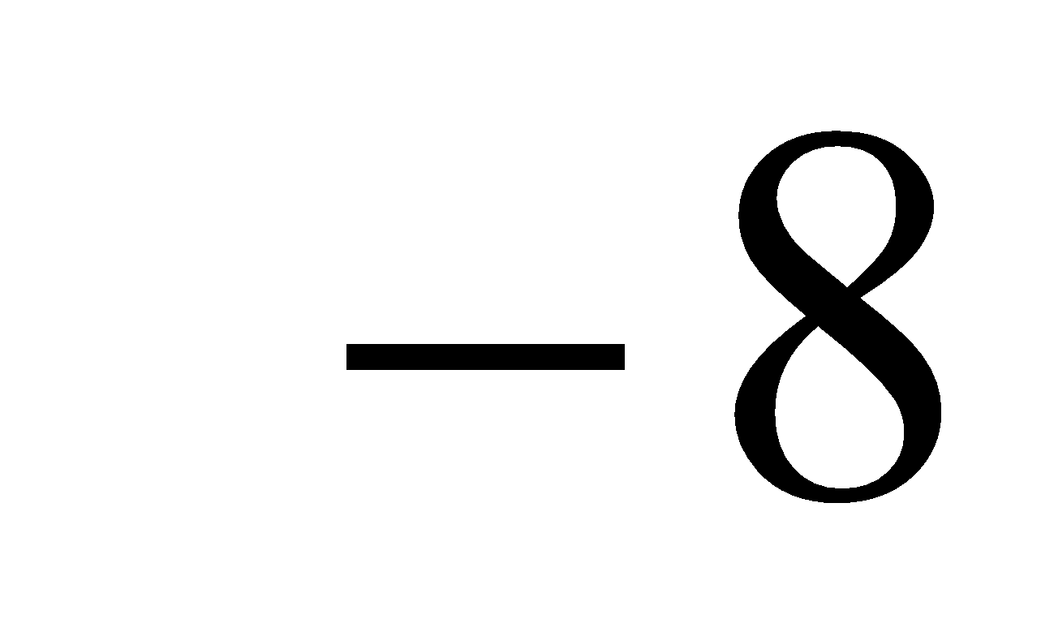
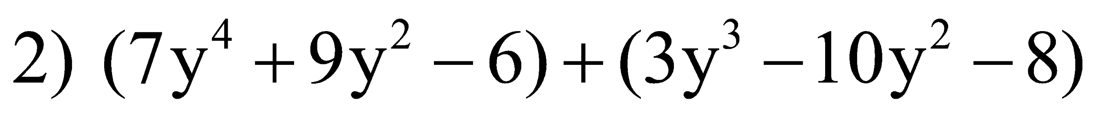
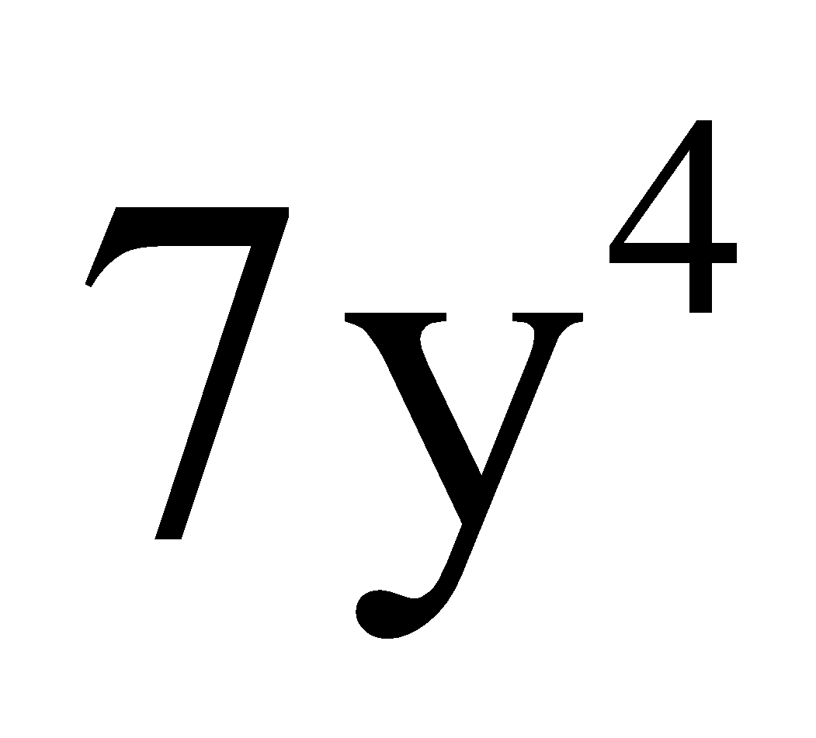
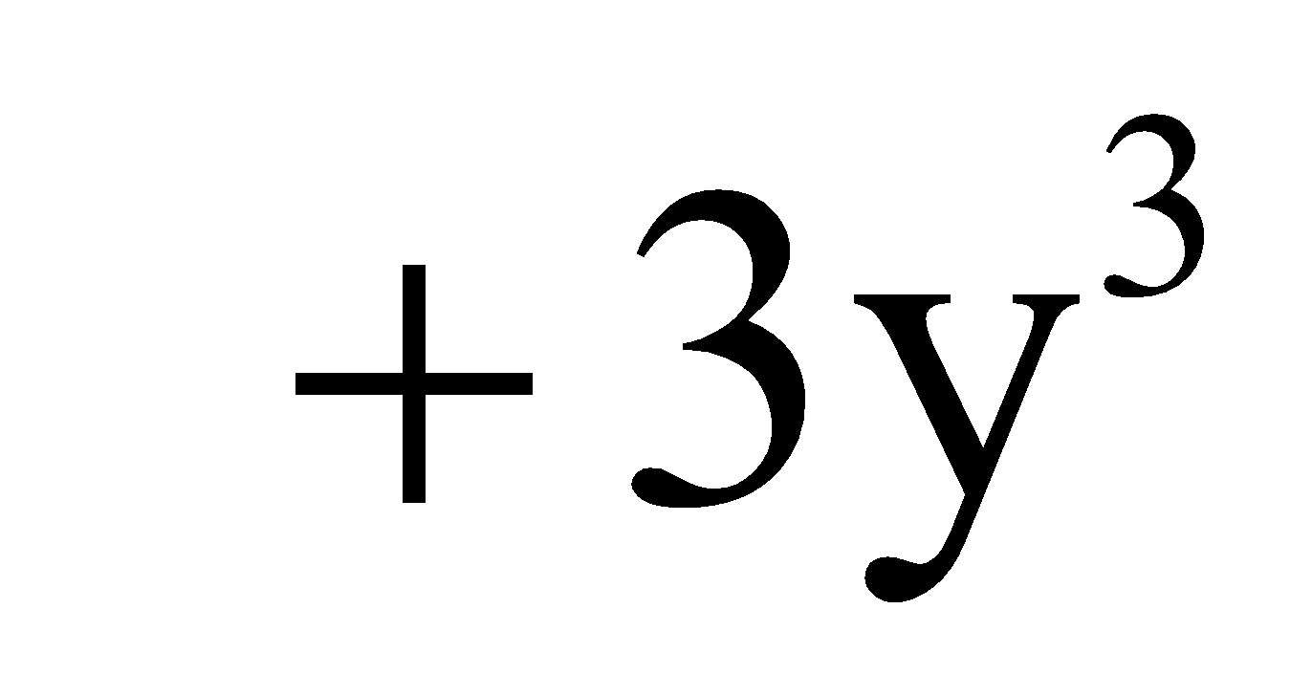
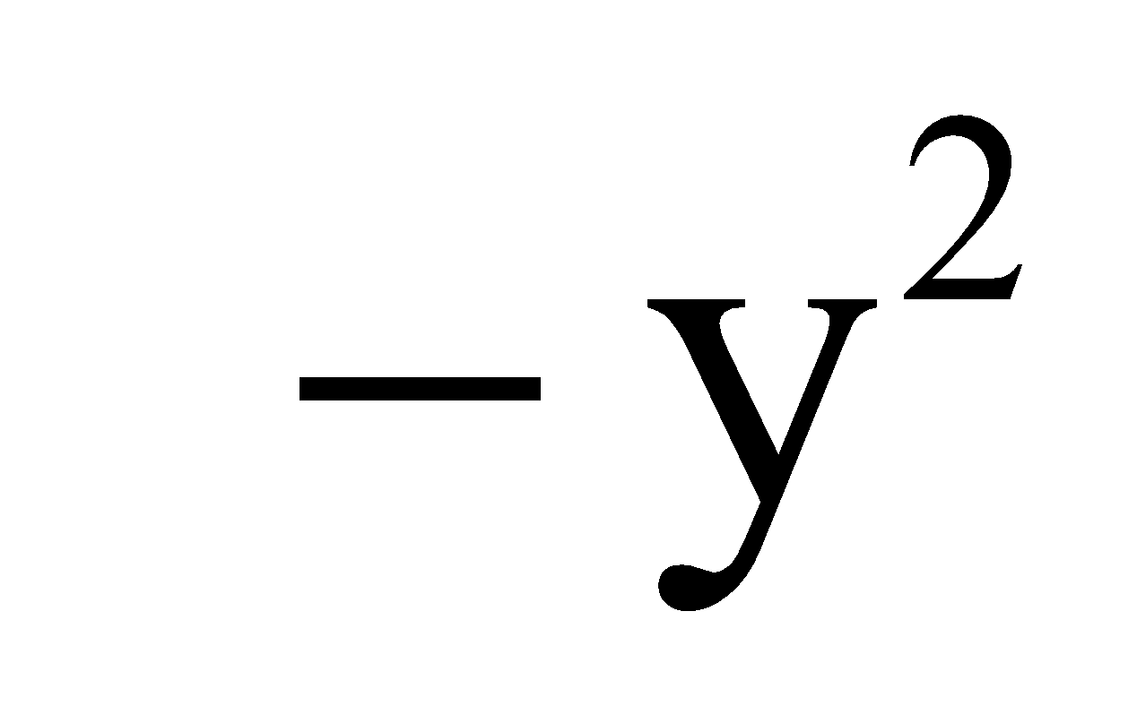
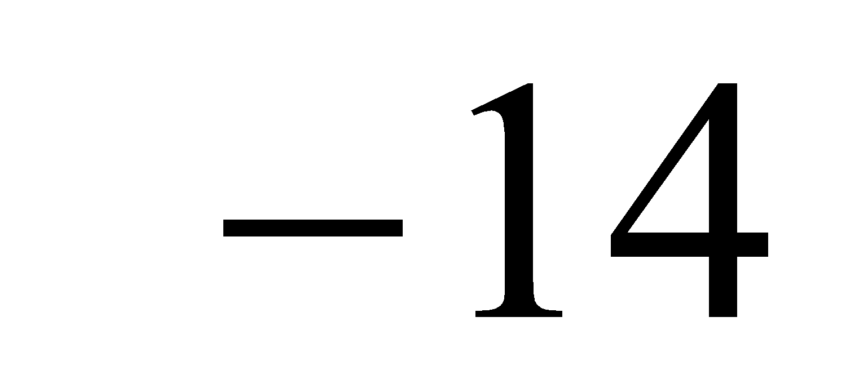
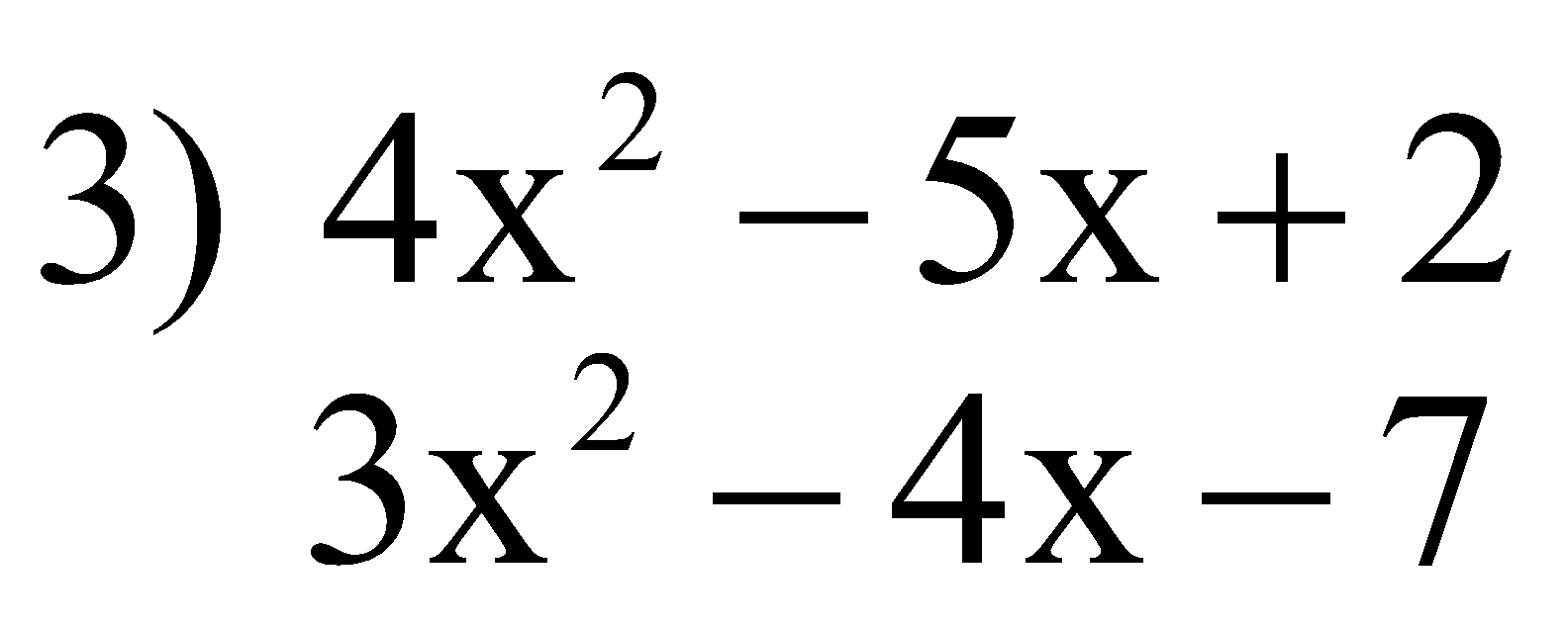
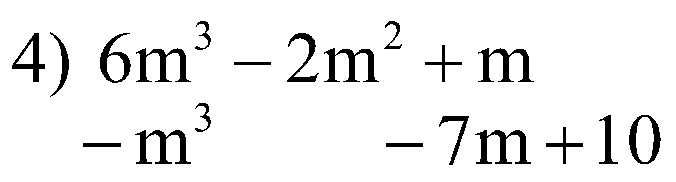
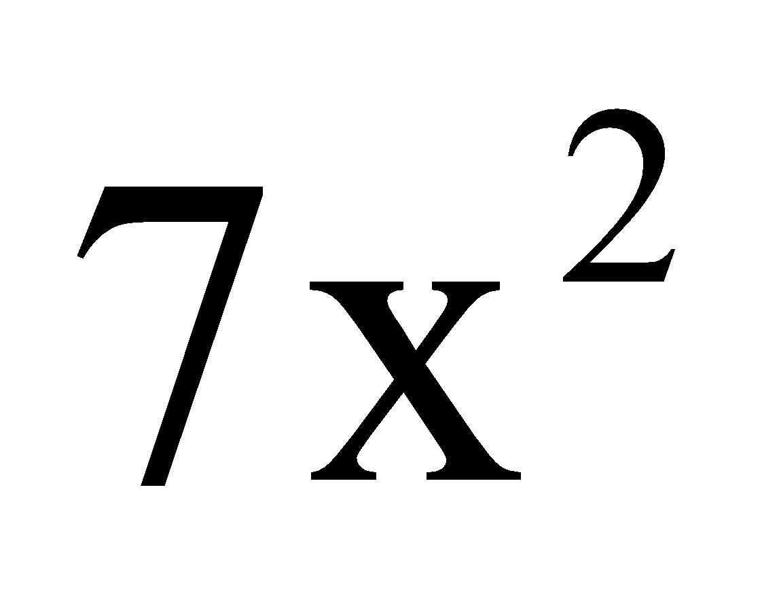
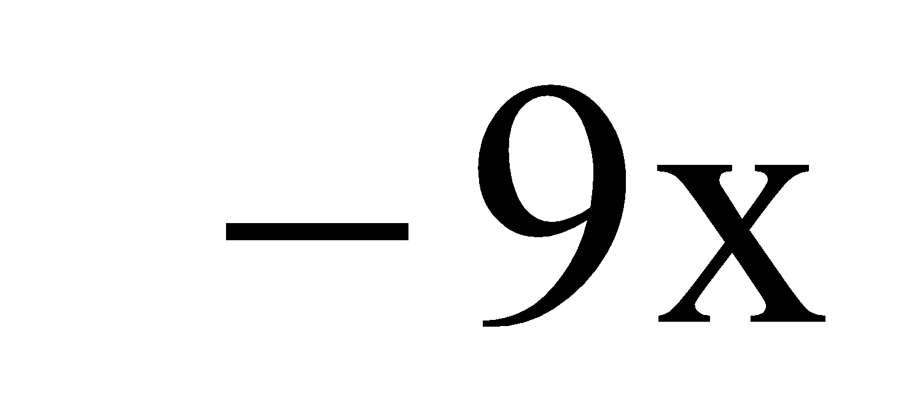
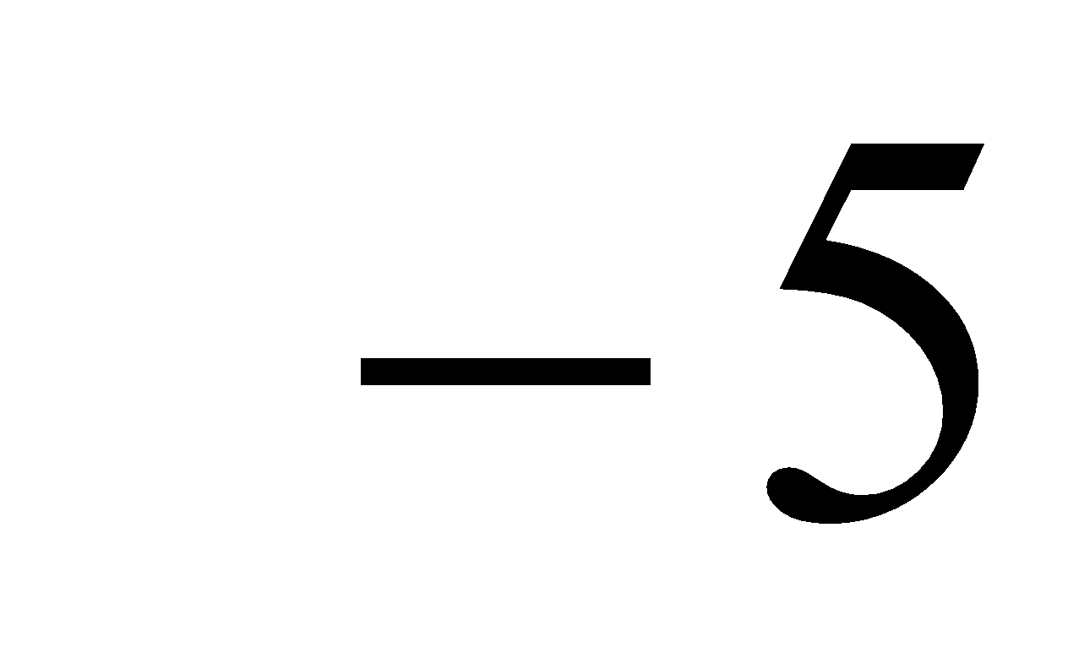
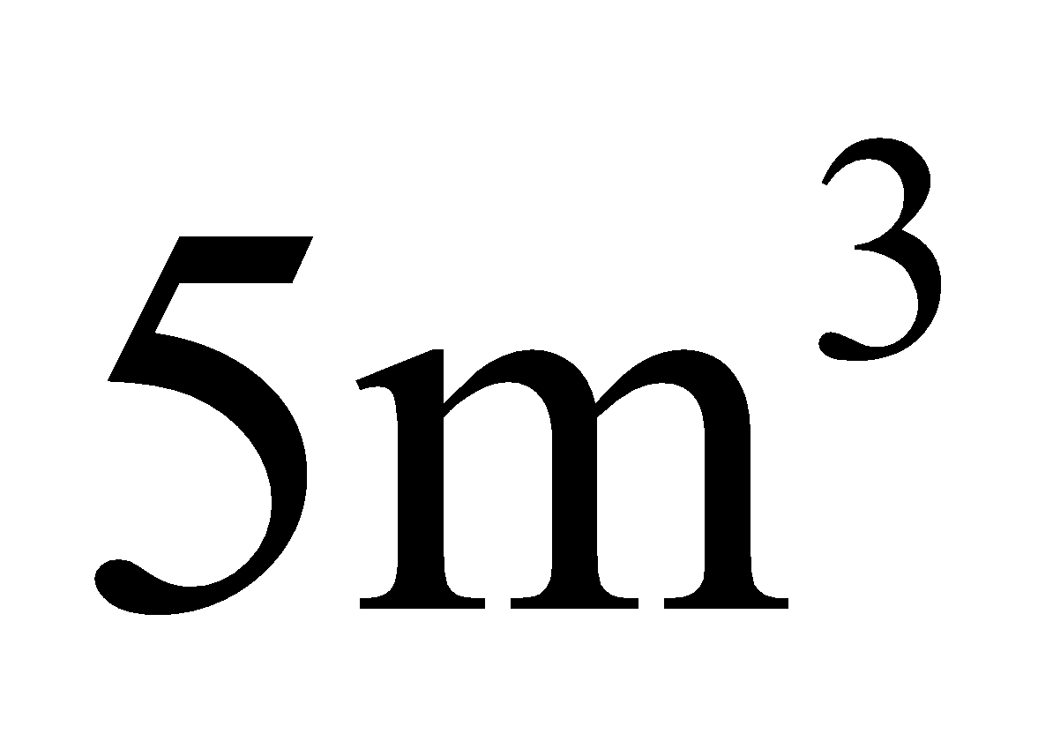
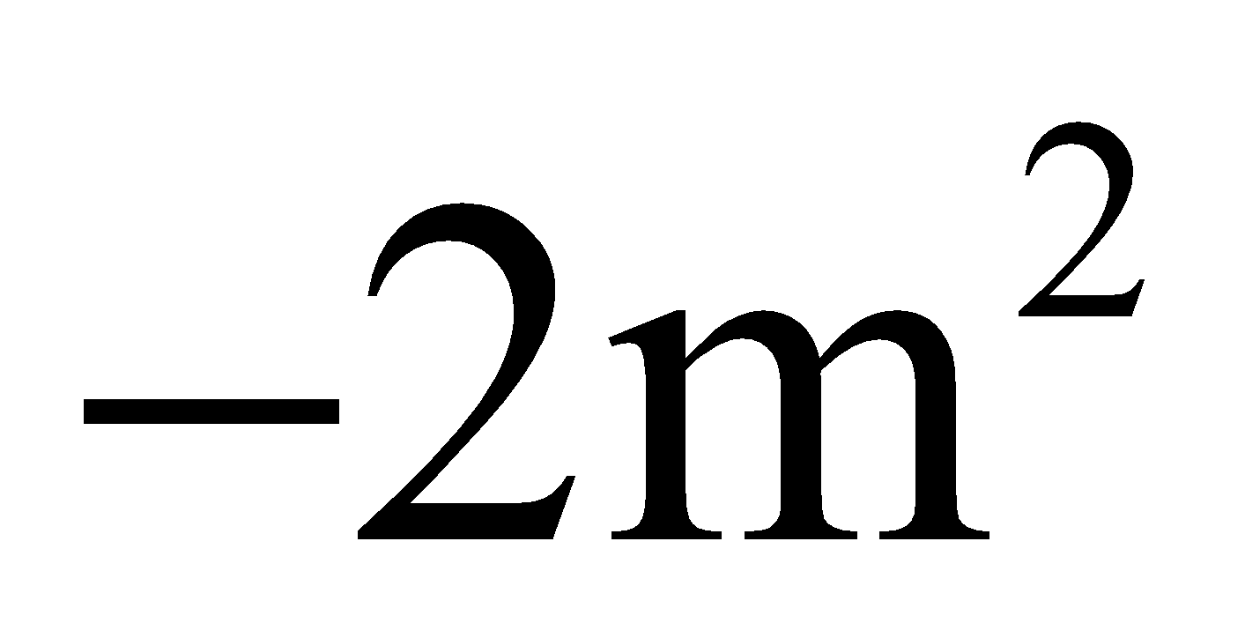
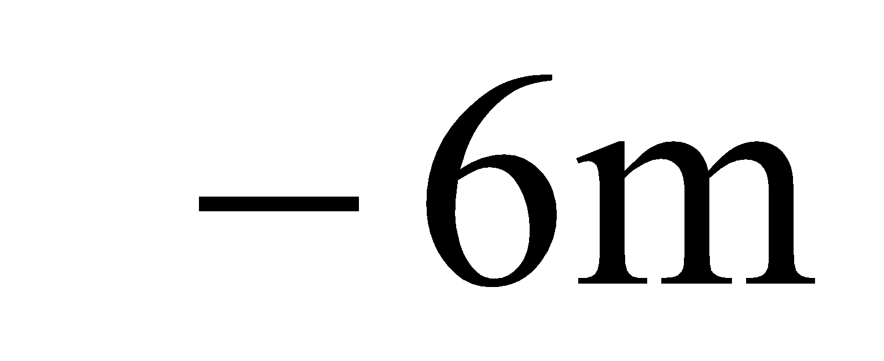
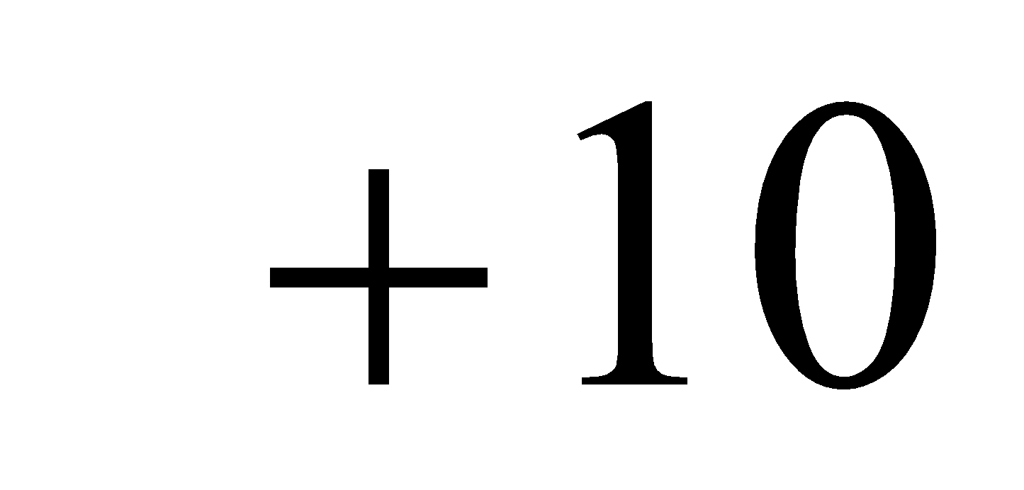
Add the polynomials.
11/27/2018
32
Notes:
32

Slide 33
Representing Polynomial using array of Structure
Consider polynomial A(x) = 2x¹⁰⁰⁰ + 1, representing using array of structure:
#define Max_Terms 100;
struct polynomial
{
int coef;
int exp;
};
typedef struct polynomial poly[Max_Terms];
 | Coeff | Expo
[0] | 2 | 1000
[1] | 1 | 0
11/27/2018
33
Notes:
33
MIT-WPU

Slide 34
Polynomial Addition
P1(x) = 3x² + 2x + 4
P3(x) = x⁴ + 10x³ + 6x² + 5
P2(x) = x⁴ + 10x³ + 3x² -2x + 1
Case 1: exponent of p1 > exponent of p2
copy term of p1 to end of p3.
[go to next term in p1]
Case 2: exponent of p1 < exponent of p2
copy term of p2 to end of p3.
[go to next term in p2]
Case 3: exponent of p1 = exponent of p2
copy term in p3 with the same exponent and with the sum of the coefficients of p1 and p2.
[go to next term in p1 & p2]

Slide 35
Algorithm polyadd (p1, p2, max1, max2)
{
i = j = k = 0;
{
while ( i < max1 && j < max2)
{
if p1[i].exp > p2[j].exp
{
p3[k] = p1[i];
k++; i++;
}
else if( p1[i].exp < p2[j].exp)
{
p3[k] = p2[j];
k++; j++;
}
else // same exponents
{ temp = p1[i].coef + p2[j].coef;
if(temp != 0)
{ p3[k].exp = p1[i].exp;
p3[k].coef = temp;
i++; j++; k++;
}
} // end while
while( i < max1 )
{
p3[k] = p1[i];
k++;
i++;
} //while
while( j < max2 )
{
p3[k] = p2[j];
k++;
j++;
} //while

Slide 36
Evaluation of Polynomial
"Evaluating" a polynomial is the same as evaluating anything else: you plug in the given value of x, and figure out what the answer will be, or, in some cases, what y is supposed to be. For instance:
Evaluate 2x³ – x² – 4x + 2 at x = –3
Plug in –3 for x, remembering to be careful with parentheses and negatives:
2(–3)³ – (–3)² – 4(–3) + 2 = 2(–27) – (9) + 12 + 2 = –54 – 9 + 14 = –63 + 14 = –49
Always remember to be careful with the minus signs!
11/27/2018
36
Notes:
36
MIT-WPU

Slide 37
Evaluation of Polynomials
Algorithm Eval_Poly
Step 1: Read the polynomial array A
Step 2: Read the value of x
Step 3: Initialize the variable sum to zero
Step4: calculate coeff * pow(x, exp) of each term and add the result to sum
Step 5: display sum
Step 6: end
11/27/2018
37
Notes:
37
MIT-WPU

Slide 38
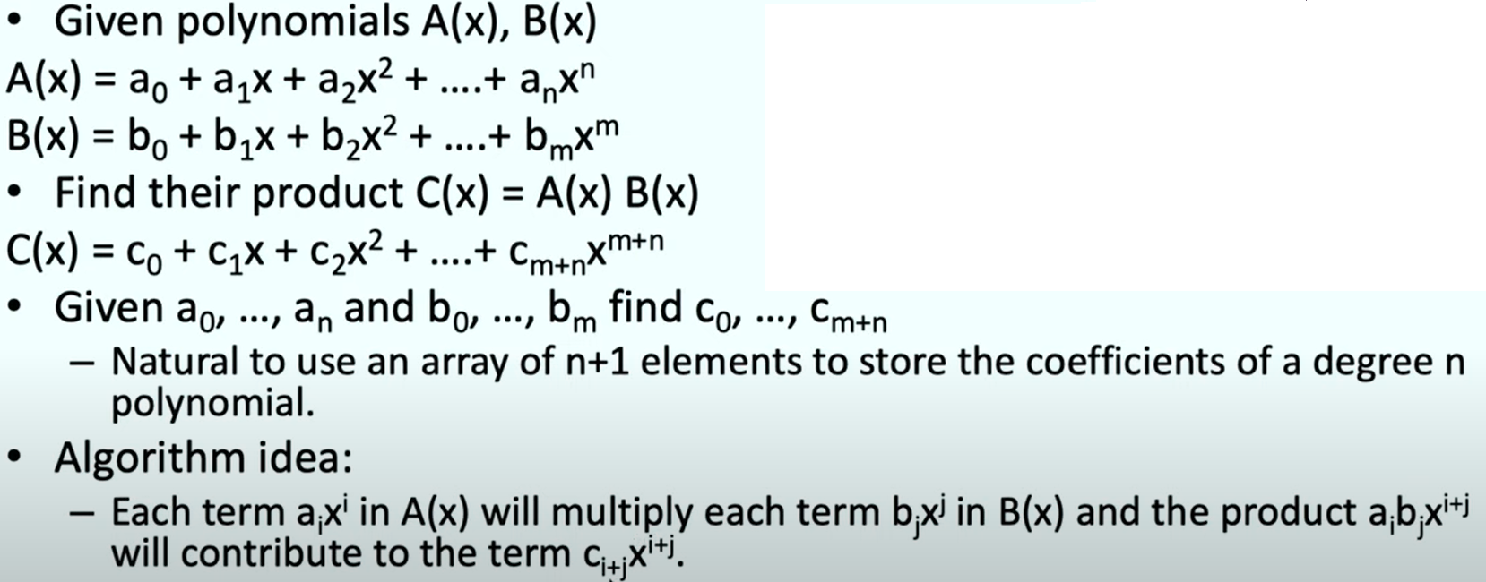
Polynomial Multiplication
Polynomial 1:
6x³ + 10x²+ 0x^¹ + 5
Polynomial 2:
4x² + 2x¹ + 1
Multiplication of Polynomials 1 & 2:
24x⁵ + 52x⁴ + 26x³ + 30x² + 10x¹ + 5
11/27/2018
LINEAR DATA STRUCTURE (DS-I)
38

Slide 39
Algorithm polymultiplication (p1, p2, max1, max2)
{
i = j = k = 0;
while ( i < max1){
j = 0;
while( j < max2)
{
temp = p1[i].coef * p2[j].coef;
if(temp != 0)
{ flag = 0;
exp = p1[i].exp + p2[j].exp;
for(x = 0; x < k; x++){
if(exp == p3[x].exp){
flag = 1;
break; }
}
if(flag == 1){
p3[x].coef = p3[x].coef + temp;
j++;
}
else{
p3[k].exp = exp;
p3[k].coef = temp;
j++; k++;
}
} // end if
} // end while
i++;
} // end while

Slide 40
Representation of sparse matrix
A matrix contains m rows and n columns of elements.
mat1(5*3)
mat2(6*6)
We write m*n to designate a matrix with m rows and n columns
 | Col0 | Col1 | Col2 | Col3 | Col4 | Col5
Row0 | 15 | 0 | 0 | 22 | 0 | -15
Row1 | 0 | 11 | 3 | 0 | 0 | 0
Row2 | 0 | 0 | 0 | -6 | 0 | 0
Row3 | 0 | 0 | 0 | 0 | 0 | 0
Row4 | 91 | 0 | 0 | 0 | 0 | 0
Row5 | 0 | 0 | 28 | 0 | 0 | 0
 | Col0 | Col1 | Col2
Row0 | -27 | 3 | 4
Row1 | 6 | 82 | -2
Row2 | 109 | -64 | 11
Row3 | 12 | 8 | 9
Row4 | 48 | 27 | 47
11/27/2018
40
Notes:
40
MIT-WPU

Slide 41
Representation of sparse matrix
In mat1 contains 15 non-zero elements but in mat2 contains 8 non-zero elements.
Any m*n matrix which contains a large number of zeros is called as sparse matrix.
We can characterize uniquely any element within a matrix by using the triple <row, col, value>.
We can use an array of triples to represent a sparse matrix.
An array of triples called as compact form.
11/27/2018
41
Notes:
41
MIT-WPU

Slide 42
Representation of sparse matrix
Each triple contains row, column and value of the non-zero elements.
The first row of compact form contains number of rows, no of columns and number of nonzero elements of original sparse matrix.
If sparse matrix contains ‘t’ non-zero elements, then the compact form has t+1 rows and 3 columns.
11/27/2018
42
Notes:
42
MIT-WPU

Slide 43
Sparse matrix in triplet form
 | Col0 | Col1 | Col2 | Col3 | Col4 | Col5
Row0 | 15 | 0 | 0 | 22 | 0 | -15
Row1 | 0 | 11 | 3 | 0 | 0 | 0
Row2 | 0 | 0 | 0 | -6 | 0 | 0
Row3 | 0 | 0 | 0 | 0 | 0 | 0
Row4 | 91 | 0 | 0 | 0 | 0 | 0
Row5 | 0 | 0 | 28 | 0 | 0 | 0
 | Col0 | Col1 | Col2
Row0 | 6 | 6 | 8
Row1 | 0 | 0 | 15
Row2 | 0 | 3 | 22
Row3 | 0 | 5 | -15
Row4 | 1 | 1 | 11
Row5 | 1 | 2 | 3
Row6 | 2 | 3 | -6
Row7 | 4 | 0 | 91
Row8 | 5 | 2 | 28
Matrix1[6][6]
Matrix2[9][3]
11/27/2018
43
Notes:
43
MIT-WPU

Slide 44
Sparse matrix in triplet form
Matrix1 is a normal matrix and Matrix2 is a compact form of Sparse matrix stored as triples
Row0 of compact form matrix contains total number of rows, columns and non-zero elements of sparse matrix.
In Normal matrix representation:
6 * 6 * 2(**)= 72 bytes are required for storage.
In Sparse matrix (Triplet) representation:
(8+1)x3x2(**) = 54 bytes are required for storage.
( ** 2 bytes are required to store integer value in 32 bits compiler)
11/27/2018
44
Notes:
44
MIT-WPU

Slide 45
Algorithm compact(A,m,n,B)
{ //m and n are tot. no. of rows. & cols. of original matrix
B(0,0)=m;
B(0,1)=n
k=1;
for i=0 to m
{
for j=0 to n
{
if(A(i,j)!=0)
{
B(k,0)=i;
B(k,1)=j;
B(k,2)=A(i,j);
k++;
} //end for j
} //end for i
}
B(0,2)=k-1;
}
 | [0] | [1] | [2] | [3] | [4] | [5]
A[0] | 15 | 0 | 0 | 22 | 0 | -15
A[1] | 0 | 11 | 3 | 0 | 0 | 0
A[2] | 0 | 0 | 0 | -6 | 0 | 0
A[3] | 0 | 0 | 0 | 0 | 0 | 0
A[4] | 91 | 0 | 0 | 0 | 0 | 0
A[5] | 0 | 0 | 28 | 0 | 0 | 0
 | Col0 | Col1 | Col2
B[0] | 6 | 6 | 8
B[1] | 0 | 0 | 15
B[2] | 0 | 3 | 22
B[3] | 0 | 5 | -15
B[4] | 1 | 1 | 11
B[5] | 1 | 2 | 3
B[6] | 2 | 3 | -6
B[7] | 4 | 0 | 91
B[8] | 5 | 2 | 28
11/27/2018
45

Slide 46
Simple Transpose
Transpose is an operation which exchanges rows and columns.
For Example:
2 | 0 | 0
0 | 0 | -3
0 | 4 | 0
Transpose
2 | 0 | 0
0 | 0 | 4
0 | -3 | 0
11/27/2018
46

Slide 47
Simple Transpose
Exchanging rows and columns
Transpose of Sparse Matrix
3 | 3 | 3
0 | 0 | 2
1 | 2 | -3
2 | 1 | 4
3 | 3 | 3
0 | 0 | 2
2 | 1 | -3
1 | 2 | 4
Transpose
Is this a correct matrix?
No, in a matrix values needs to stored sequentially(row & column wise)
11/27/2018
47

Slide 48
Simple Transpose
Now we will see how to find out simple transpose of sparse matrix.
3 | 3 | 9
0 | 0 | 2
0 | 1 | -3
0 | 2 | 4
1 | 0 | 5
1 | 1 | 6
1 | 2 | 1
2 | 0 | 7
2 | 1 | 8
2 | 2 | 3
1.Traverse Second column of sparse matrix
2.Search for column indexes in sequence from 0 to number of columns-1
Transpose
3.Copy the rows (from 1 to number of non-zero terms) in sequence to transpose matrix.
11/27/2018
48

Slide 49
Simple Transpose of Sparse Matrix
 | Col0 | Col1 | Col2
Row0 | 6 | 6 | 8
Row1 | 0 | 0 | 15
Row2 | 0 | 3 | 22
Row3 | 0 | 5 | -15
Row4 | 1 | 1 | 11
Row5 | 1 | 2 | 3
Row6 | 2 | 3 | -6
Row7 | 4 | 0 | 91
Row8 | 5 | 2 | 28
 | Col0 | Col1 | Col2
Row0 | 6 | 6 | 8
(a) (b)
(a) shows a sparse matrix and (b) shows its transpose stored as triples.
Row1 | 0 | 0 | 15
Row2 | 0 | 4 | 91
Row3 | 1 | 1 | 11
Row4 | 2 | 1 | 3
Row5 | 2 | 5 | 28
Row6 | 3 | 0 | 22
Row7 | 3 | 2 | -6
Row8 | 5 | 0 | -15
11/27/2018
49
Notes:
49
MIT-WPU

Slide 50
Simple Transpose of Sparse Matrix
Transpose of a matrix is obtained by interchanging rows and columns.
In another way, we can say that element in the i, j position gets put in the j, i position.
But this is not the case with sparse matrix triple form.
To find transpose of sparse matrix triple form, find all elements in col0 and store then in row0 of the transpose matrix, find all elements in col1 and store then in row1 of the transpose matrix, and so on.
Since the original matrix ordered the rows, the columns within each row of the transpose matrix will be arranged in ascending order as well.
11/27/2018
50
Notes:
50
MIT-WPU

Slide 51
Algorithm of Simple Transpose of Sparse Matrix
 | [0] | [1] | [2] | [3] | [4] | [5]
A[0] | 15 | 0 | 0 | 22 | 0 | -15
A[1] | 0 | 11 | 3 | 0 | 0 | 0
A[2] | 0 | 0 | 0 | -6 | 0 | 0
A[3] | 0 | 0 | 0 | 0 | 0 | 0
A[4] | 91 | 0 | 0 | 0 | 0 | 0
A[5] | 0 | 0 | 28 | 0 | 0 | 0
Algorithm Transpose(A,B)
// A is a matrix represented in sparse form. B is set to be its transpose.
1 (m,n,t) :=(A(0,0), A(0,1), A(0,2))
2 (B(0,0), B(0,1), B(0,2)) := (n,m,t)
3 if t<=0 then return //check for zero matrix
4 q :=1 //q is position of next term in B
5 for col :=0 to n do //transpose by column
6 for p:=1 to t do //for all nonzero term do
7 if A(p,1) = col then //correct column
8 {(B(q,0), B(q,1), B(q,2)) := (A(p,1), A(p,0), A(p,2))
9 q:=q+1}
10 end
11 end
12 end Transpose
 | Col0 | Col1 | Col2
B[0] | 6 | 6 | 8
B[1] | 0 | 0 | 15
B[2] | 0 | 3 | 22
B[3] | 0 | 5 | -15
B[4] | 1 | 1 | 11
B[5] | 1 | 2 | 3
B[6] | 2 | 3 | -6
B[7] | 4 | 0 | 91
B[8] | 5 | 2 | 28
11/27/2018
51
Notes:
51
MIT-WPU

Slide 52
Difference between Fast and Simple Transpose
Time Complexity of Simple Transpose
= O(n*t)
Time Complexity of Fast Transpose
=O(n+t)
11/27/2018
52

Slide 53
Fast Transpose
Exchanging rows and columns
Transpose of Sparse Matrix
3 | 3 | 3
0 | 0 | 2
1 | 2 | -3
2 | 1 | 4
3 | 3 | 3
0 | 0 | 2
1 | 2 | 4
2 | 1 | -3
Transpose
Is this a correct matrix?
Yes, because row and column indices are in sequence.
11/27/2018
53

Slide 54
Fast Transpose
Now we will see how to find out fast transpose of sparse matrix.
3 | 3 | 9
0 | 0 | 2
0 | 1 | -3
0 | 2 | 4
1 | 0 | 5
1 | 1 | 6
1 | 2 | 1
2 | 0 | 7
2 | 1 | 8
2 | 2 | 3
1.Calculate frequency of each column value
2.Use frequency of each column value to find
location of each row in transpose matrix.
Transpose
3.Copy row containing first zero at location zero.
11/27/2018
54

Slide 55
Fast Transpose of Sparse Matrix
Time complexity of simple transpose, is O(columns*elements)
We can transpose a matrix as a sequence of triples in time (columns + elements)
Fast_Transpose proceeds by first determining the number of elements in each column of A
This gives us the number of elements in each row of B. From this information, the starting point in B of each of its rows is easily obtained.
We can now move the elements of A one by one into their correct position in B.
11/27/2018
55
Notes:
55
MIT-WPU

Slide 56
Fast Transpose of Sparse Matrix
 | Col0 | Col1 | Col2
Row0 | 6 | 6 | 8
Row1 | 0 | 0 | 15
Row2 | 0 | 3 | 22
Row3 | 0 | 5 | -15
Row4 | 1 | 1 | 11
Row5 | 1 | 2 | 3
Row6 | 2 | 3 | -6
Row7 | 4 | 0 | 91
Row8 | 5 | 2 | 28
 | Col0 | Col1 | Col2
Row0 | 6 | 6 | 8
(a) (b)
(a) shows a sparse matrix and (b) shows its transpose stored as triples.
Row1 | 0 | 0 | 15
Row2 | 0 | 4 | 91
Row3 | 1 | 1 | 11
Row4 | 2 | 1 | 3
Row5 | 2 | 5 | 28
Row6 | 3 | 0 | 22
Row7 | 3 | 2 | -6
Row8 | 5 | 0 | -15
11/27/2018
56
Notes:
56
MIT-WPU

Slide 57
Algorithm of Fast Transpose of Sparse Matrix
 | Col0 | Col1 | Col2
Row0 | 6 | 6 | 8
Row1 | 0 | 0 | 15
Row2 | 0 | 3 | 22
Row3 | 0 | 5 | -15
Row4 | 1 | 1 | 11
Row5 | 1 | 2 | 3
Row6 | 2 | 3 | -6
Row7 | 4 | 0 | 91
Row8 | 5 | 2 | 28
procedure FAST_TRANSPOSE(A,B)
// A is a matrix represented in sparse form. B is set to be its transpose. t is non-zero terms
declare S(n), T(n); //local array
1 (m,n,t) := (A(0,0), A(0,1), A(0,2))
2 (B(0,0), B(0,1), B(0,2)) := (n,m,t)
3 if t<=0 then return //check for zero matrix
4 for i:=0 to n do S(i) :=0 end
5 for i:= 1 to t do //S(k) is the number of elements in row k of B
6 S(A(i, 1)) := S(A(i, 1)) + 1 //elements in row k of B
7 end
8 T(0):=1 //T(i) is the starting position of row i in B
9 for i:=1 to n do
10 T(i) := T(i -1 ) + S(i - 1)
11 end
12 for i:=1 to t do //move all t elements of A to B//
13 j := A(i,1) //j is the row in B//
14 (B(T(j),0), B(T(j),1), B(T(j),2)) := (A(i,1), A(i,0), A(i,2)) //store in triple//
15 T(j) :=T(j) + 1 //increase row j to next spot//
16 end
17 end FAST_TRANSPOSE
 | Col0 | Col1 | Col2
Row0 | 6 | 6 | 8
Row1 | 0 | 0 | 15
Row2 | 0 | 4 | 91
Row3 | 1 | 1 | 11
Row4 | 2 | 1 | 3
Row5 | 2 | 5 | 28
Row6 | 3 | 0 | 22
Row7 | 3 | 2 | -6
Row8 | 5 | 0 | -15
11/27/2018
57
Notes:
57
MIT-WPU

Slide 58
Additions of two Sparse Matrices
 | Col0 | Col1 | Col2
Row0 | 6 | 6
Row1 | 0 | 0 | 30
Row2 | 0 | 3 | 22
Row3 | 0 | 4 | 91
Row4 | 0 | 5 | -15
Row5 | 1 | 1 | 22
Row6 | 1 | 2 | 3
Row7 | 2 | 1 | 3
Row8 | 2 | 3 | -6
Row9 | 3 | 2 | -6
Row10 | 4 | 0 | 91
Row11 | 5 | 2 | 28
 | Col0 | Col1 | Col2
Row0 | 6 | 6 | 8
Row1 | 0 | 0 | 15
Row2 | 0 | 3 | 22
Row3 | 0 | 5 | -15
Row4 | 1 | 1 | 11
Row5 | 1 | 2 | 3
Row6 | 2 | 3 | -6
Row7 | 4 | 0 | 91
Row8 | 5 | 2 | 28
 | Col0 | Col1 | Col2
Row0 | 6 | 6 | 8
Row1 | 0 | 0 | 15
Row2 | 0 | 4 | 91
Row3 | 1 | 1 | 11
Row4 | 2 | 1 | 3
Row7 | 3 | 2 | -6
11
11/27/2018
58
Notes:
58
MIT-WPU

Slide 59
Algorithm - Addition of Sparse Matrix
Algorithm Addition(a, b, c)
//a and b are two sparse matrices in compact form. C is the resultant sparse matrix in compact form.
if a(0,0) = b(0,0) and a(0,1) = b(0,1)
if t1=0 and t2 = 0 then stop
c(0,0) = a(0,0) ; c(0,1) = a(0,1) ;
End
i =j =k = 1
while ( i<= t1 and j <= t2)
Case A : a(i ,0) = b(j ,0) // row position
Case 1 : a(i ,1) = b(j ,1 ) //col position
temp = a(i ,2) + b(j ,2)
if temp != 0
c(k , 0) = a(i , 0)
c(k , 1) = a(i , 1)
c(k , 2) = temp
k = k+1
end if
i = i +1; j=j+1;
Case 2 : if a(i ,1) < b(j , 1)
c(k , 0) = a(i , 0)
c(k , 1) = a(i , 1)
c(k , 2) = a(i , 2)
k = k+1
i = i +1
Case 3 : if a(i ,1) > b(j , 1)
c(k , 0) = b(j , 0)
c(k , 1) = b(j , 1)
c(k , 2) = b( j , 2)
k = k+1
j = j +1
Case B : if a(i ,0) < b(j , 0)
c(k , 0) = a(i , 0)
c(k , 1) = a(i , 1)
c(k , 2) = a( i , 2)
k = k+1
i = i +1
11/27/2018
59
Notes:
59
MIT-WPU

Slide 60
Algorithm - Addition of Sparse Matrix
Case C : if a(i ,0) > b(j , 0)
c(k , 0) = b(j , 0)
c(k , 1) = b(j , 1)
c(k , 2) = b( j , 2)
k = k+1
j = j +1
end while
while (i <= t1)
{
c := a
i ++; k++;
}
while (j <= t2)
{
c := b
j ++; k++;
}
c(0,2) = k-1
end Addition
11/27/2018
60
Notes:
60
MIT-WPU

Slide 61
FAQ
What is sparse matrix? List the applications?
Represent sparse matrix with suitable data structures? Explain with example simple and fast transpose?
Explain sequential memory organization with suitable example?
Explain row major and column major representation of a matric? Show address calculation with example?
11/27/2018
61
Notes:
61
MIT-WPU

Slide 62
FAQ
Find out the addition of two sparse matrices in triplet form and also find Simple and Fast transpose?
+
Represent the following polynomial using array:
3x3y2+10xy4+10x+1
21+x4-5x7+18x68
5x2+10xy+y2+20
5x3y2z+3x2y3z2+6xyz3+10
10x3y2z-8x3y3z3+5xyz2+10
+
4 | 5 | 6
0 | 3 | 7
0 | 4 | 6
1 | 4 | 4
2 | 1 | 8
3 | 2 | 45
4 | 4 | 21
4 | 5 | 6
0 | 3 | 5
1 | 3 | 8
1 | 4 | 45
2 | 3 | 4
3 | 2 | 45
4 | 1 | 2
11/27/2018
62
Notes:
62
MIT-WPU

Slide 63
FAQ
Each element of an array Data[20][50] requires 4 bytes of storage. Base address of data is 2000. determine the location of Data[10][10] when the array is stored as i) row major and ii) column major?
Consider the liner array A(5:50). BA=300 and the number of words per memory cell is 4 bytes. Find address of A[15]?
Consider int arr[4][5]. BA=1020. Find the address of arr[3][4] with row-major and column major representation?
Consider int arr[5][4]. BA=510. Find the address of arr[3][2] with row-major and column major representation?
11/27/2018
63
Notes:
63
MIT-WPU

Slide 64
FAQ
Each element of an array Data[20][50] requires 4 bytes of storage. Base address of data is 2000. determine the location of Data[10][10] when the array is stored as i) row major and ii) column major?
Consider the liner array A(5:50). BA=300 and the number of words per memory cell is 4 bytes. Find address of A[15]?
Consider int arr[4][5]. BA=1020. Find the address of arr[3][4] with row-major and column major representation?
Consider int arr[5][4]. BA=510. Find the address of arr[3][2] with row-major and column major representation?
11/27/2018
64
Notes:
64
MIT-WPU

Slide 65
Examples
A farmer must add the areas of two plots of land to determine the amount of seed to plant. The area of plot A can be represented by 3x² + 7x – 5, and the area of plot B can be represented by 5x² – 4x + 11. Write a polynomial that represents the total area of both plots of land.
(3x² + 7x – 5)
Plot A.
+
(5x² – 4x + 11)
Plot B.
8x² + 3x + 6
Combine like terms.
11/27/2018
65
Notes:
65
MIT-WPU

Slide 66
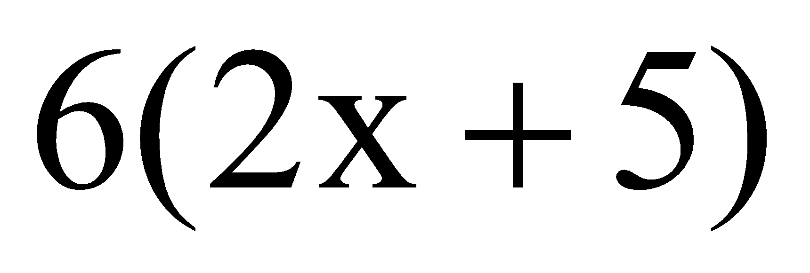
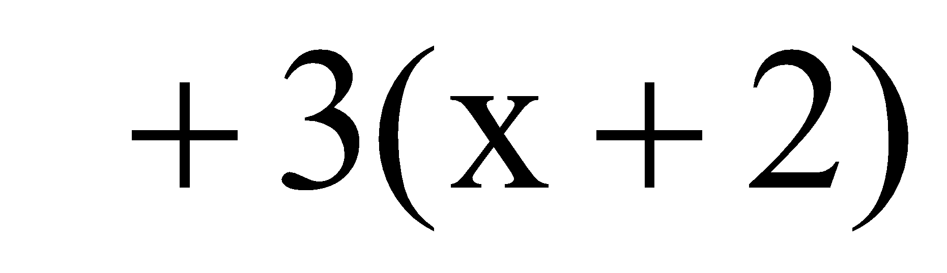
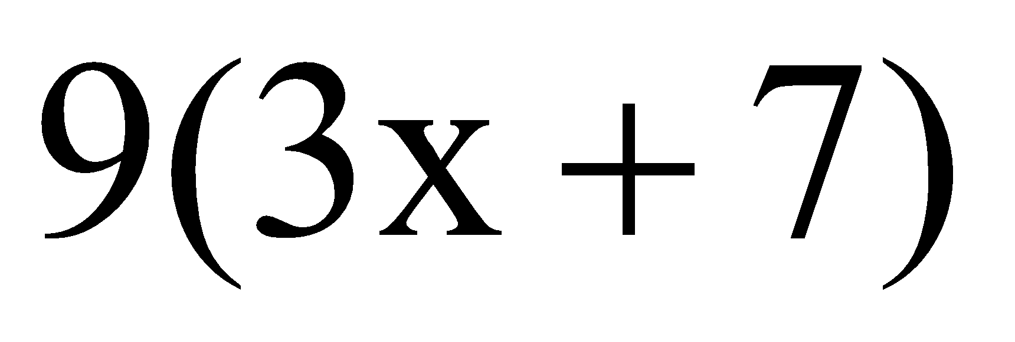
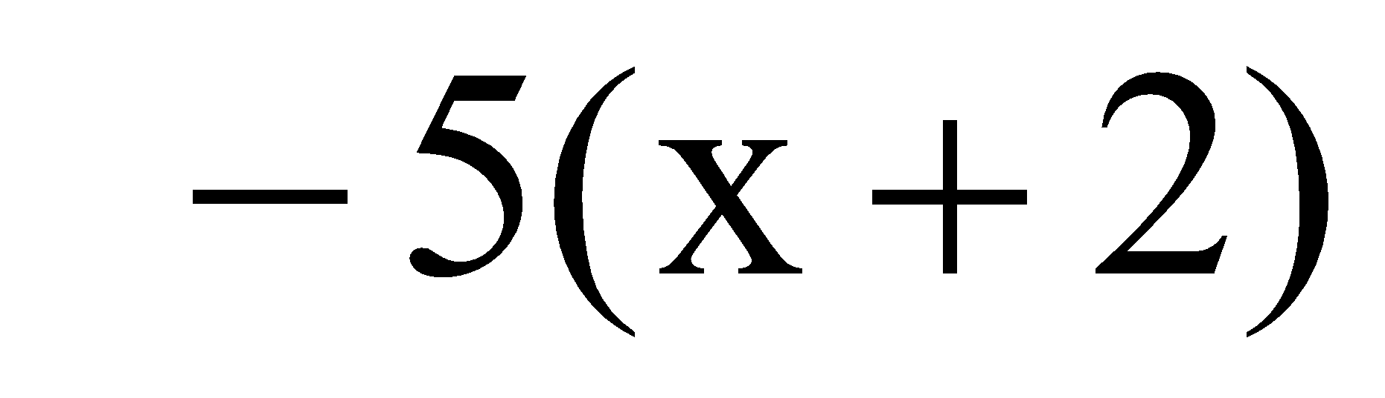
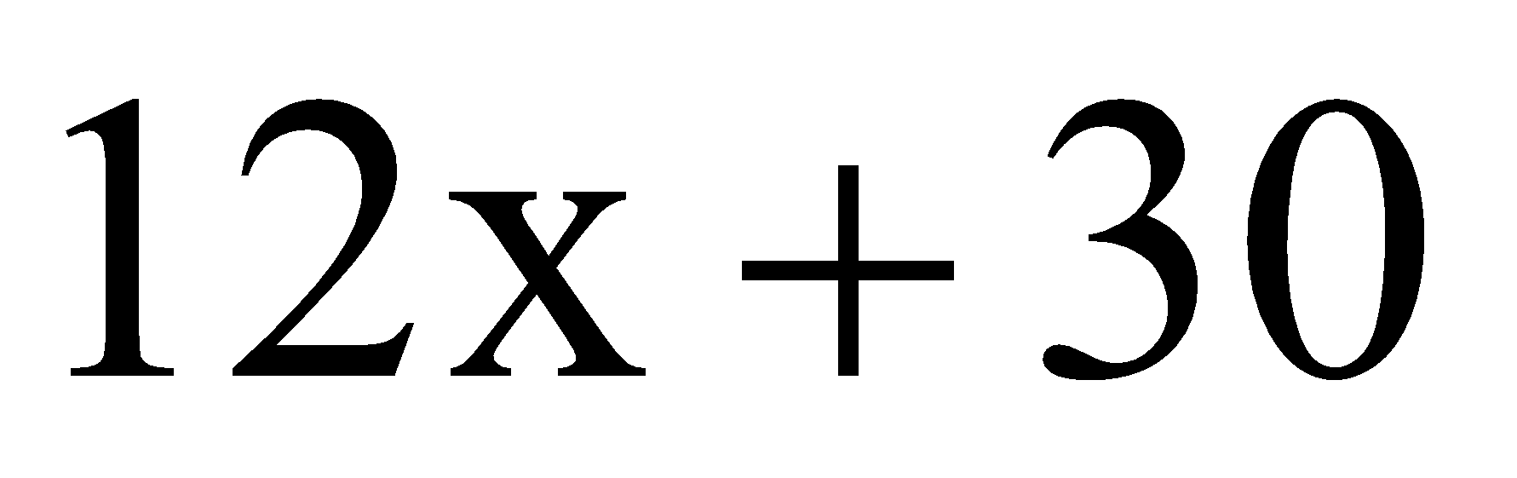
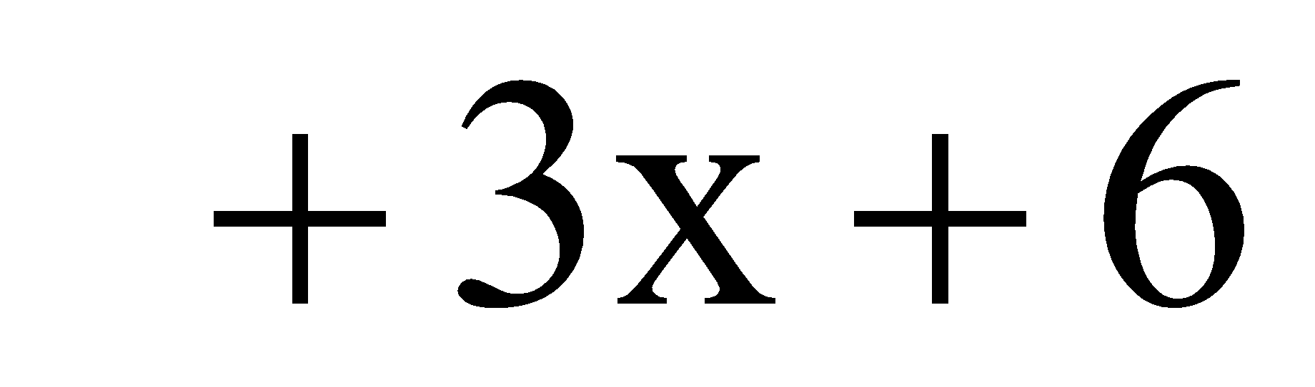
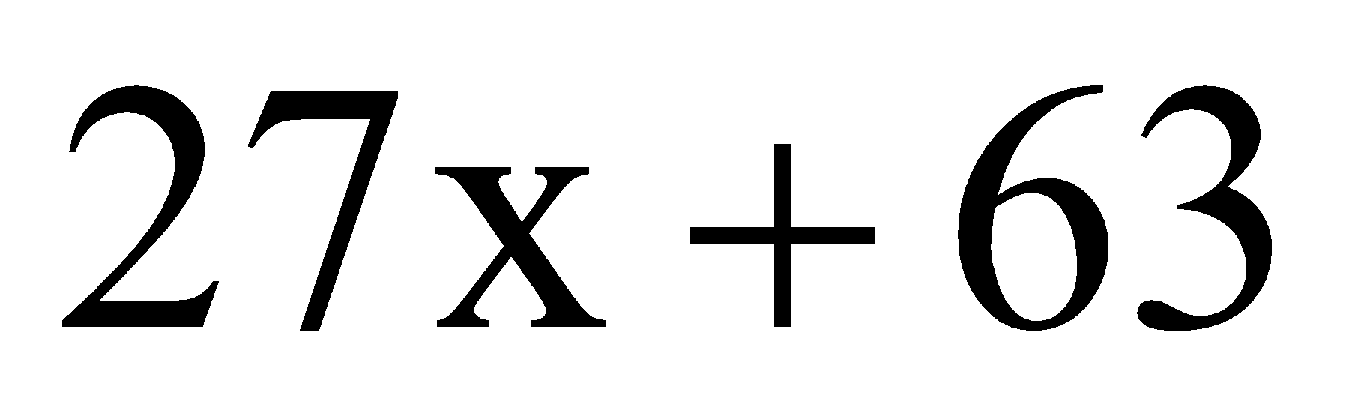
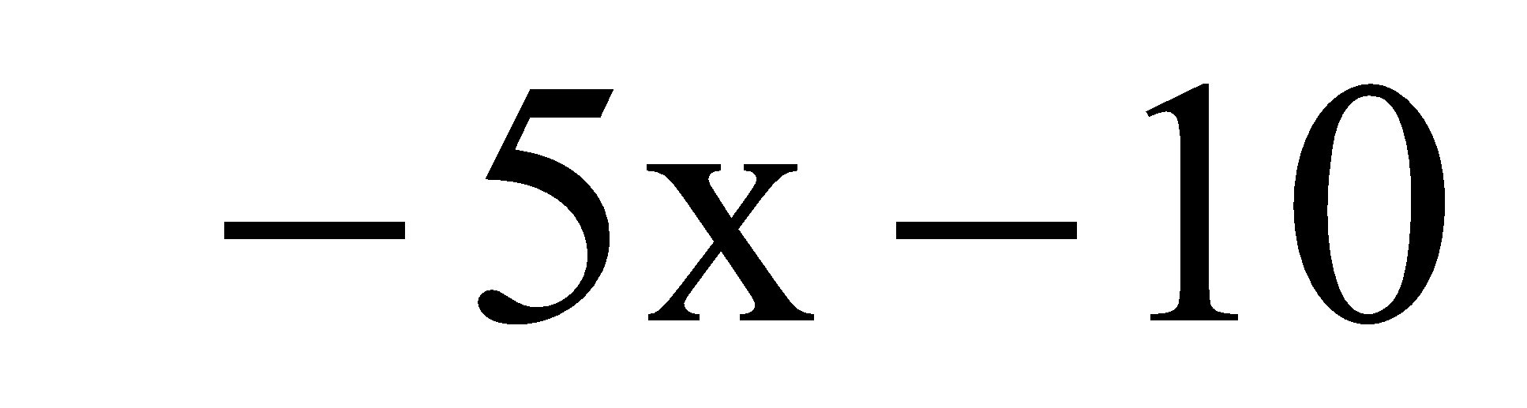
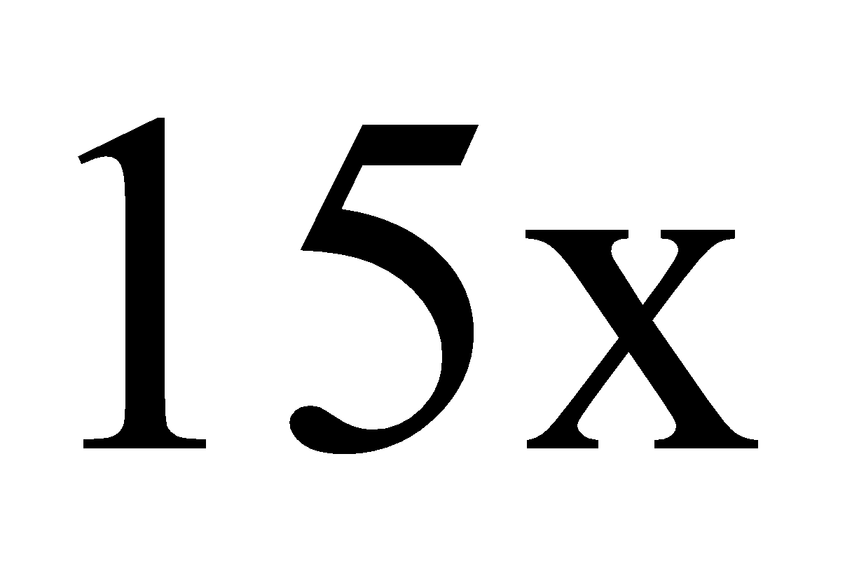
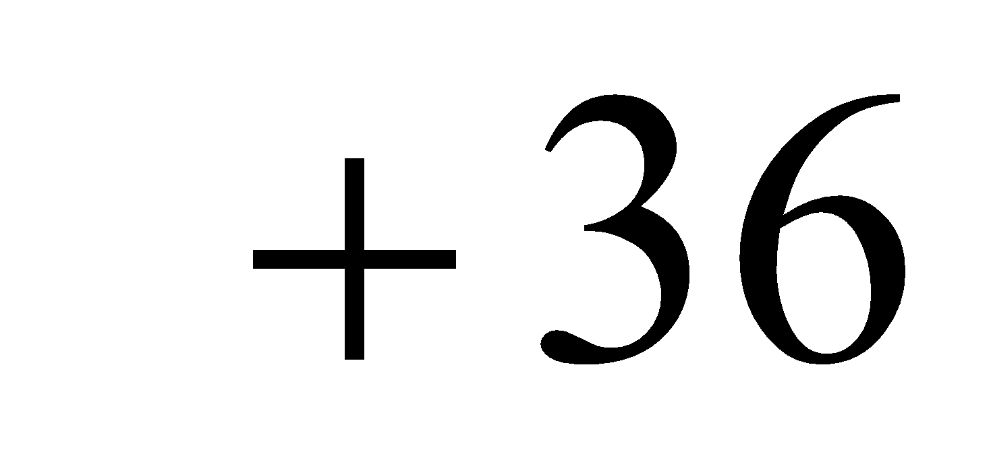
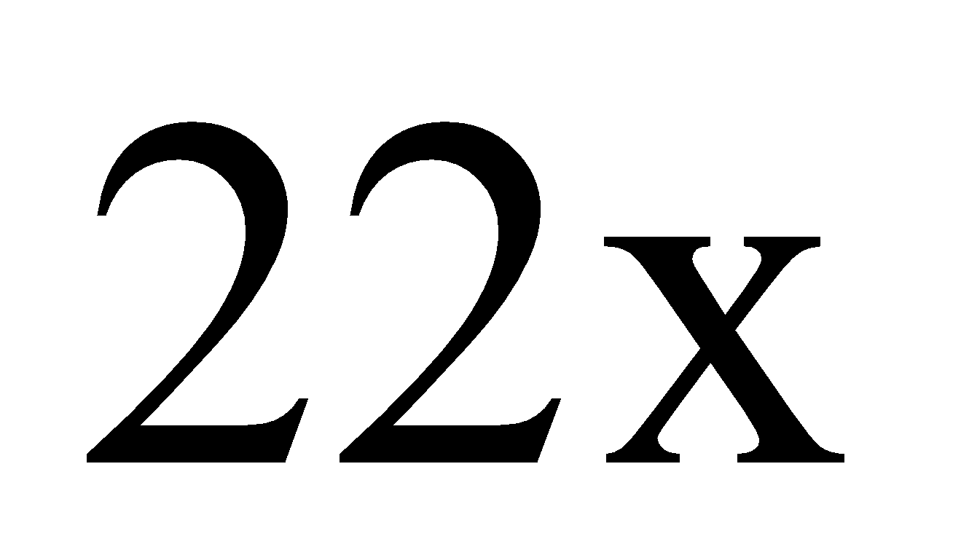
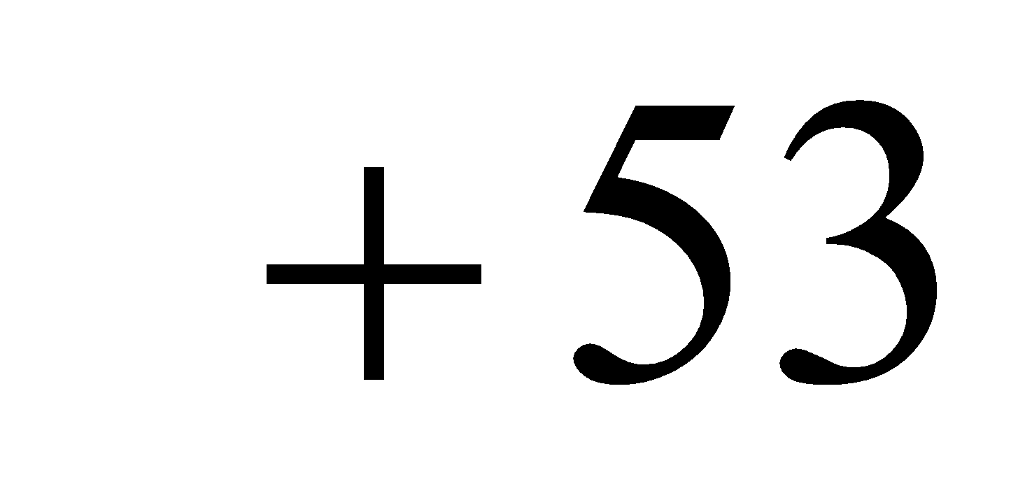
1)
x + 2
2)
3
9
5
5
6
x + 2
x + 2
2x + 5
3x + 7
11/27/2018
66
Notes:
66

Slide 67
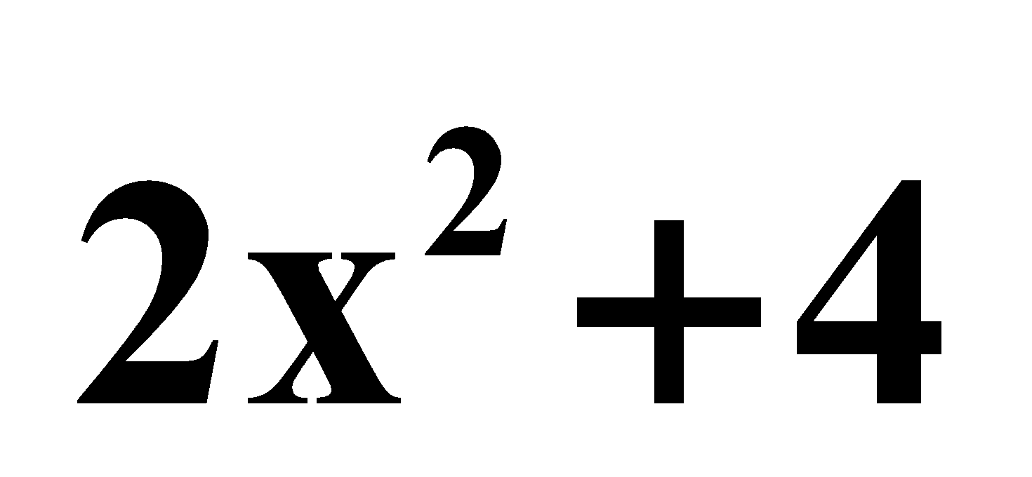
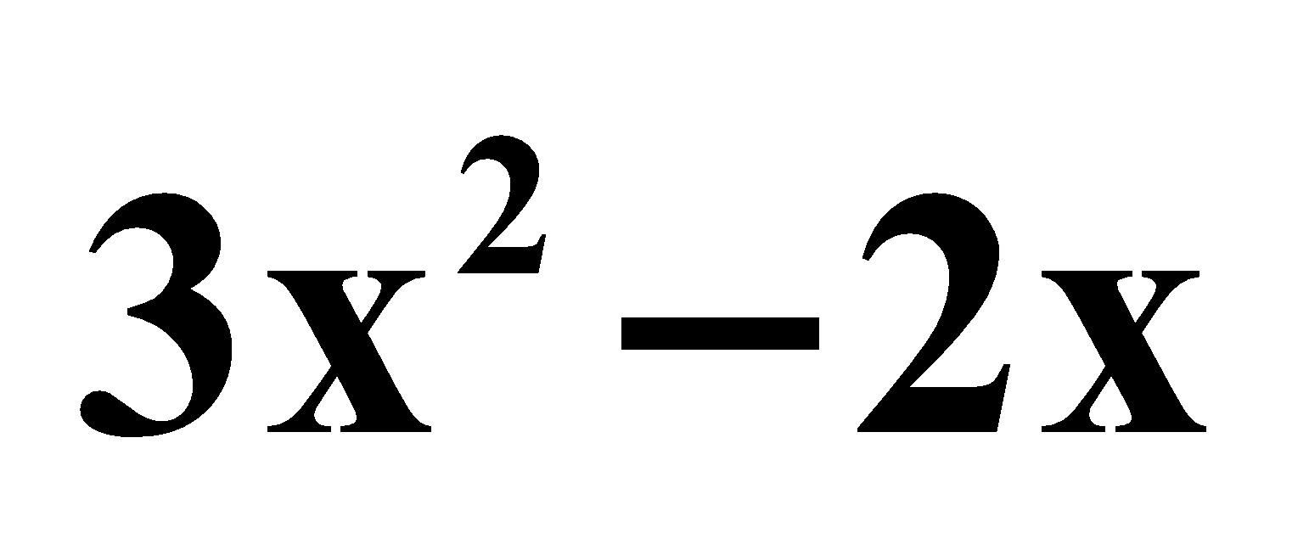
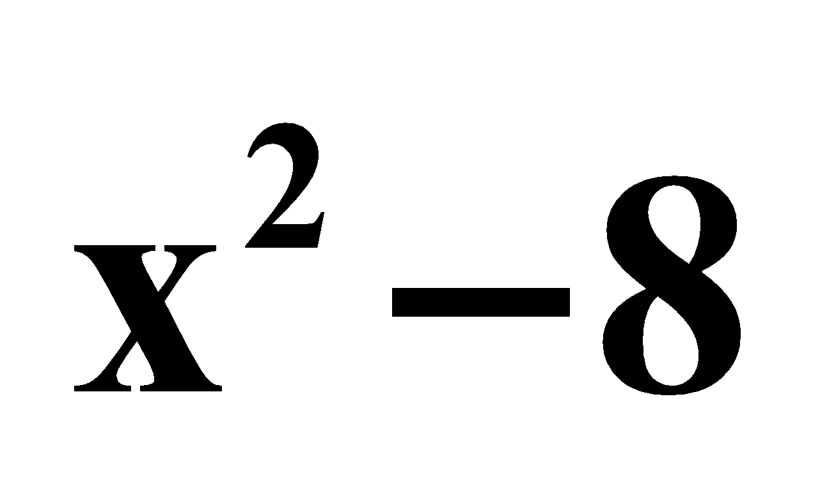
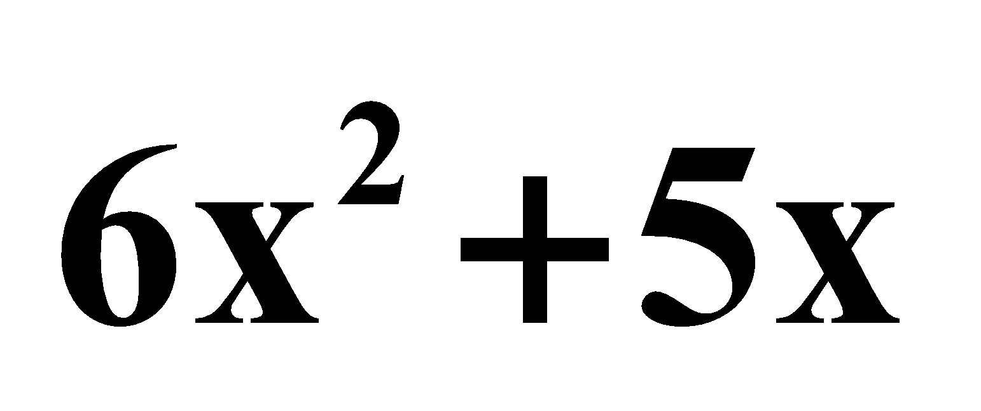
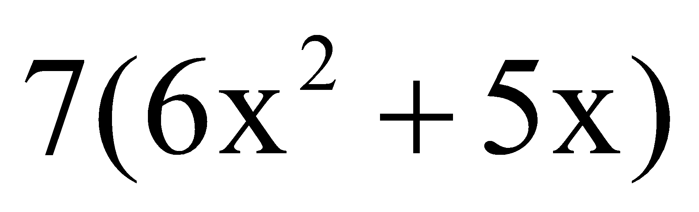
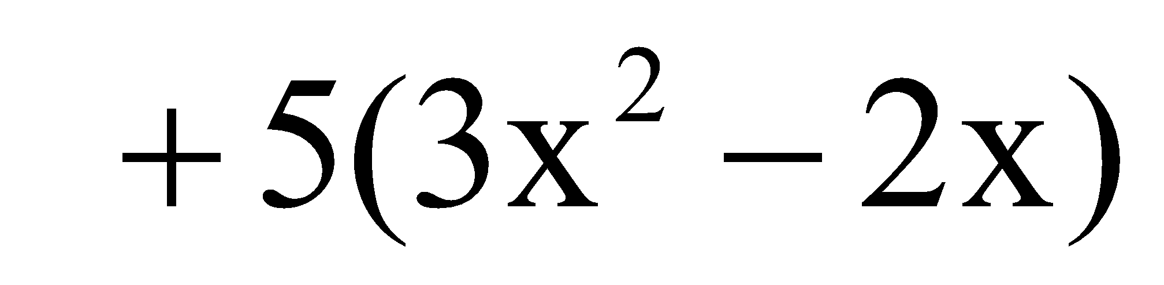
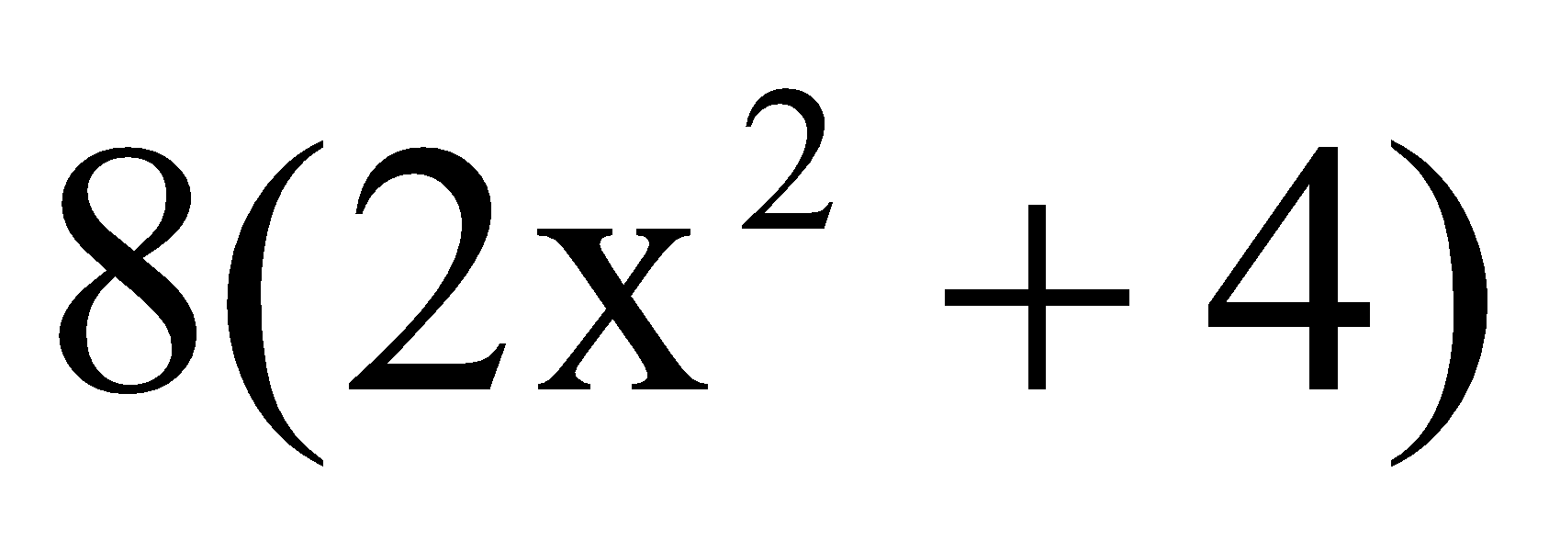
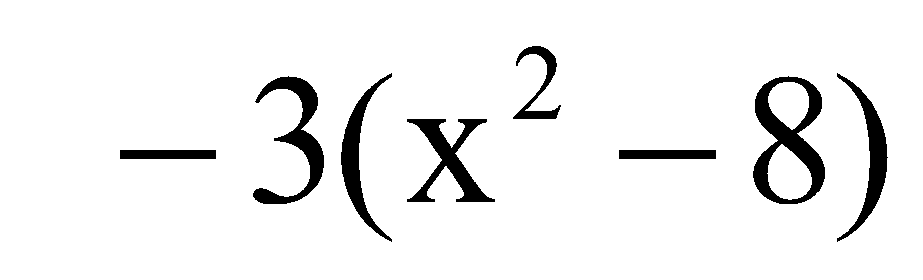








Write an expression that represents the area of
the shaded region in terms of x.
1)
2)
5
8
7
3
3
11/27/2018
LINEAR DATA STRUCTURE (DS-I)
67
Notes:
67

Slide 68
Add or subtract.
1. 7m² + 3m + 4m²
2. (r² + s²) – (5r² + 4s²)
3. (10pq + 3p) + (2pq – 5p + 6pq)
4. (14d² – 8) + (6d² – 2d + 1)
11m² + 3m
–4r² – 3s²
18pq – 2p
20d² – 2d – 7
5. (2.5ab + 14b) – (–1.5ab + 4b)
4ab + 10b
11/27/2018
68

Slide 69
6. A painter must add the areas of two walls to determine the amount of paint needed. The area of the first wall is modeled by 4x² + 12x + 9, and the area of the second wall is modeled by
36x² – 12x + 1. Write a polynomial that represents the total area of the two walls.
40x² + 10
11/27/2018
69

Slide 70
Practice Assignments
Implement Array as an Abstract Data Type using Sequential Organization?
Representation of Polynomials using arrays and perform operations
Addition of two polynomials
Evaluation of Polynomial
11/27/2018
70
Notes:
70
MIT-WPU

Slide 71
Takeaway
Study the concept of Sequential Organization and its Memory Representation and Address Calculation.
Learn Representation and operations of polynomial such as Addition and Evaluation.
Study and implement sparse matrix concept and operations such as Simple Transpose, Fast Transpose and Addition
11/27/2018
71
Notes:
71
MIT-WPU

Slide 72
References
E. Horowitz, S. Sahani, S. Anderson-Freed, "Fundamentals of Data Structures in C", Universities Press, 2008
Treamblay, Sorenson, “An introduction to data structures with applications”, Tata McGraw Hill, Second Edition
Aaron Tanenbaum, “Data Structures using C”, Pearson Education
R. Gilberg, B. Forouzan, "Data Structures: A pseudo code approach with C", Cenage Learning, ISBN 9788131503140
11/27/2018
72
Notes:
72
MIT-WPU

